Slide 1
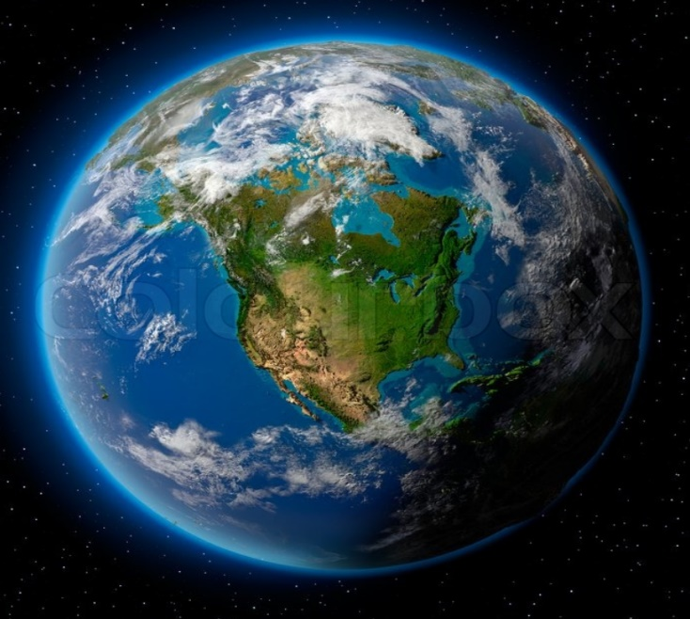
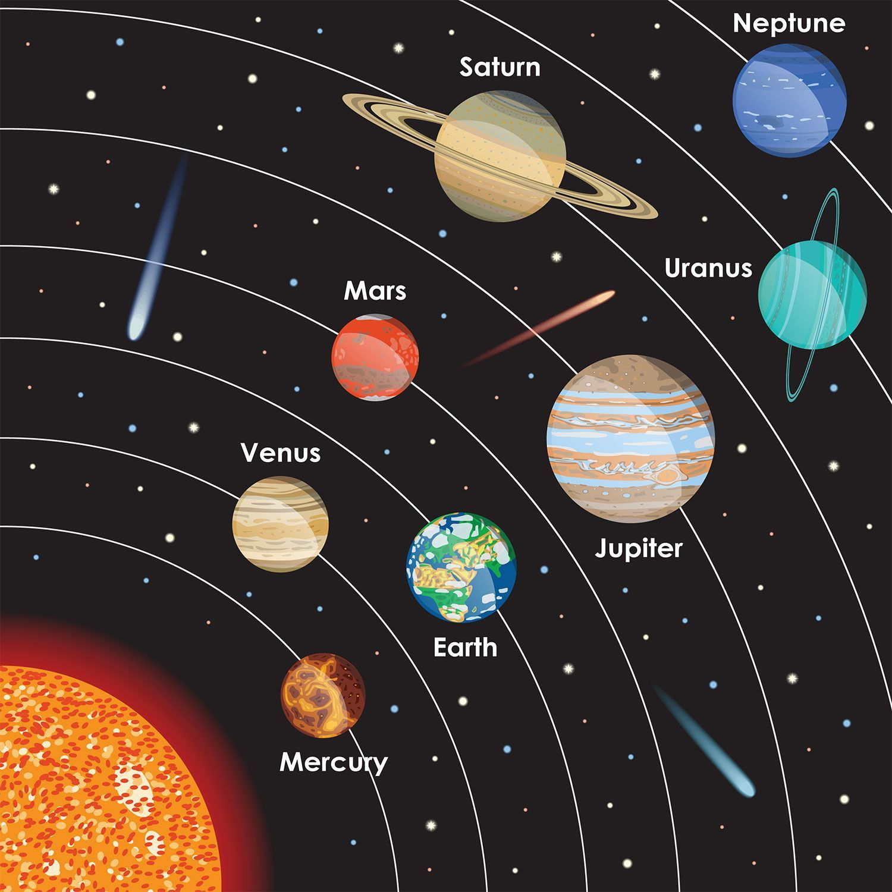
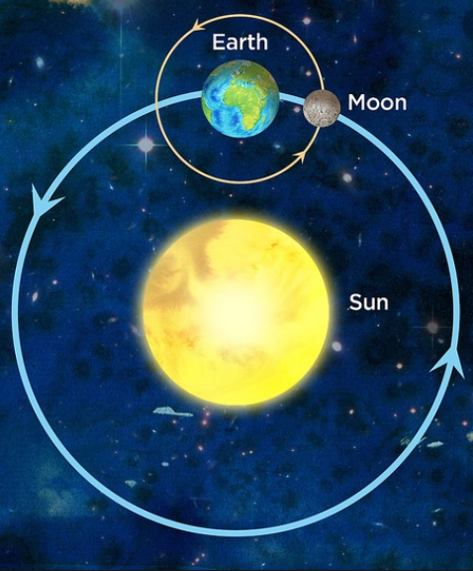
Earth and Space – Year 5
The Sun, the Moon and Earth
The Sun is a star: a huge ball of hot gas that gives off light & heat. The Earth (and all of the planets in the Solar System) orbit the Sun.
It takes the Earth just over 365 days to make one complete orbit around the Sun.
The Earth is always spinning around. When a point on Earth is facing the Sun, it is daytime. When facing away, it is nighttime. It takes 24 hours for the Earth to complete a spin (one day).
Some objects orbit around the planets. These are called moons. The Earth has one moon. The Moon is much smaller than the Earth, and takes one full day to complete an orbit around the Earth.
The Earth is a part of the Solar System. At the centre of the Solar System is the Sun. The Sun is a star.
There are 8 planets and 5 dwarf planets in the Solar System, which orbit the Sun.
The Solar System
The Solar System includes the Sun and all of the objects that orbit around it due to gravity.
The Earth is one of eight planets that orbit the Sun. It is the third closest to the Sun.
Earth is the only known planet in the Solar System where there are living things. The planets closer to the Sun are thought to be too hot, whilst some of those further away are too cold.
Many of the planets (including Earth) have moons which orbit them.
The Sun is gigantic, but it is just one of billions of stars in our galaxy.
Orbit - go around

Slide 2
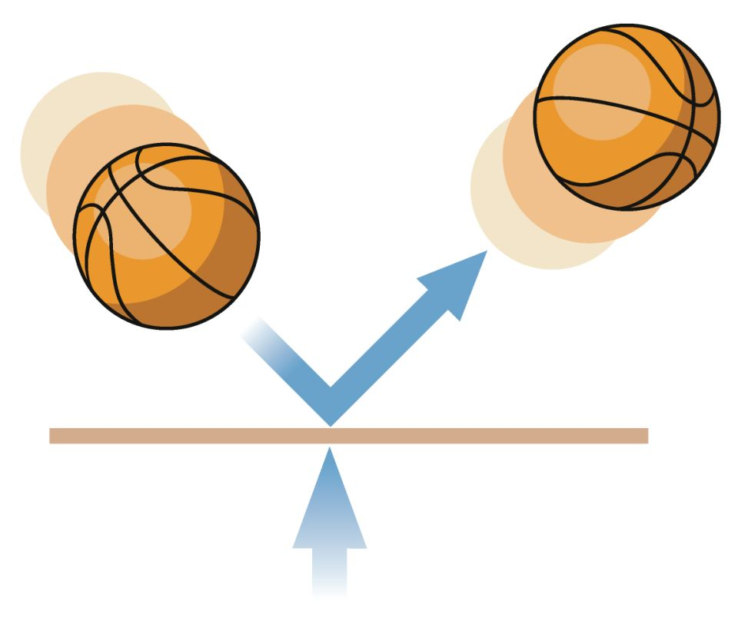
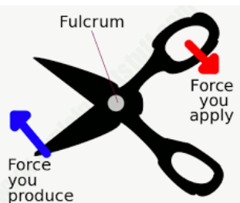
Forces – Year 5
Forces are pushes and pulls which make things move and stop moving.
Most forces need contact between objects, but magnets can act at a distance.
Forces are shown by arrows in diagrams. The bigger the arrow, the bigger the force.
When forces are unbalanced, objects can speed up, slow down, or change direction.
Gravity
Gravity attracts all matter towards each other.
The bigger an object’s mass, the more gravity it will have.
Sir Isaac Newton discovered gravity around 300 years ago.
We can’t actually feel gravity, but we feel the effect of trying to overcome it by jumping or when we fall.
Key Vocabulary | Definition
Applied force | the force placed on an object by a living creature
Friction | the sticking force that occurs when an object moves over another
Air resistance | type of friction force that pulls against an object travelling through the air.
Water resistance | type of friction force on objects floating or moving in water
Surface resistance | friction force of objects moving across a surface
Simple machines and mechanisms include pulleys, gears and levers. They can be used to turn a small force into larger forces.
Levers give us extra pushing or pulling force and help us lift greater weights.
Gears are different sized cogs which work together to give a machine extra force.
Pulleys are wheels and ropes that work together to life heavy objects.

Slide 3
Living things and their habitats – Year 5
Growth and Development of Animals
Humans | House Mice | African Elephants | Saltwater Crocodiles | Blue Whales
Gestation Period: 9 months Sexual Maturity: 11-17 years Life Expectancy: 80 years | Gestation Period: 20 days Sexual Maturity: 4-6 weeks Life Expectancy: 1 year | Gestation Period: 22 months Sexual Maturity: 10-12 years Life Expectancy: 60 years | Gestation Period: 2-3 months Sexual Maturity: 10-12 years Life Expectancy: 70 years | Gestation Period: 10-12 months Sexual Maturity: 10 years Life Expectancy: 90 years
Gestation – the process of developing inside the womb between conception and birth

Slide 4
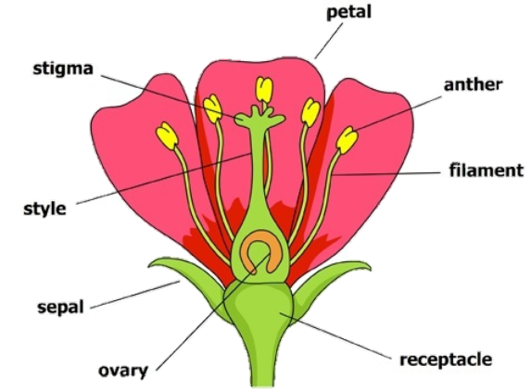
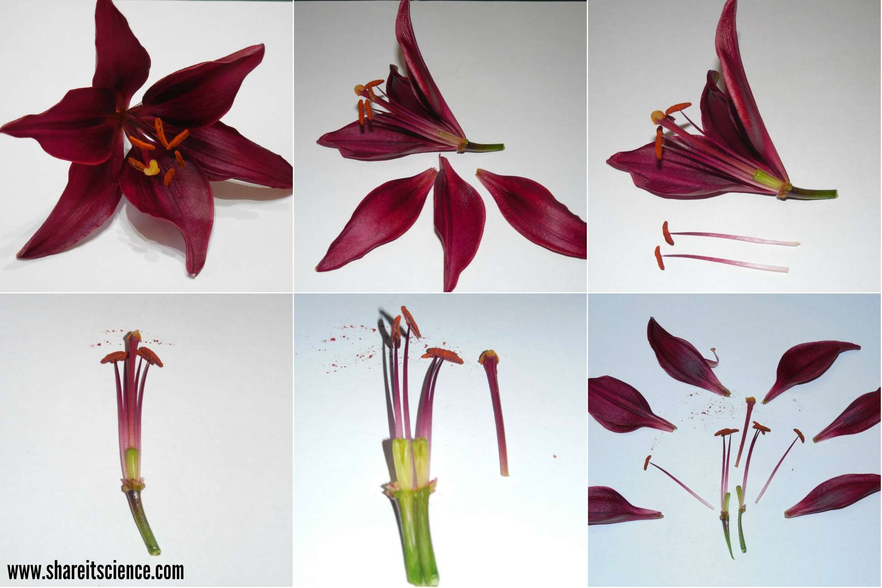
Living things and their habitats – Year 5
Seed Dispersal
There are many different ways that seeds can be dispersed (moved away from the parent plant). Some common methods of seed dispersal are:
Wind dispersal
Explosion seed dispersal
Animal dispersal
Water dispersal
Sexual reproduction in plants is cyclical, following this process:
Germination | The plant begins to grow from a seed. Roots grow from under the soil, then a stem, leaves and flower shoots above the surface.
Pollination | Pollen produced by the flower is carried by insects or blown by the wind to another flower.
Fertilisation | The pollen reaches another flower and makes its way to the ovary, where it is fertilised.
Dispersal | The seeds are scattered by animals or the wind.
Asexual reproduction involves plants producing an identical copy of themselves.
This can happen in a number of different ways. Some plants are able to produce bulbs. Others produce tubers which lie below the soil and grow into plants the next year.
Parts of a flower
Dissection of a flower

Slide 5
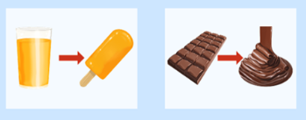
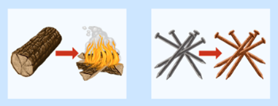
Materials – Year 5
(States of Matter)
Materials are the substances that things are made from.
The properties of materials make them useful for different purposes.
There are three main states of matter – solids, liquids, and gases.
The state of matter of materials can change, through processes such as freezing and melting.
Separation of mixtures
Filtering – pass (a liquid, gas, light, or sound) through a device to remove unwanted material
Sieving – to strain solids from liquids
Evaporating – turn from liquid into vapour
Grouping materials by properties
Property | Yes | No
Electrical conductor | Copper, aluminum, gold, silver, steel, sea water | Glass, air, plastic, rubber, wood, oil, diamond
Magnetic | Steel, nickel, cobalt, iron, uranium, platinum | Paper, glass, plastic, rubber, wood, wool
Transparent | Glass, water, clear plastic | Wood, rubber, oil, steel, copper, iron, silver
Waterproof | Plastic, rubber, metal, glass | Tissue, sponge, fabric
REVERSIBLE CHANGES
Reversible changes – Some changes to materials can be changed, for example through heating and cooling.
Irreversible changes – these changes cannot be undone, for example, cooking, baking or burning materials.
IRREVERSIBLE CHANGES

Slide 6
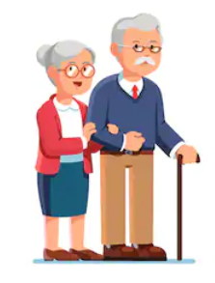
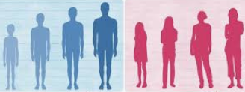
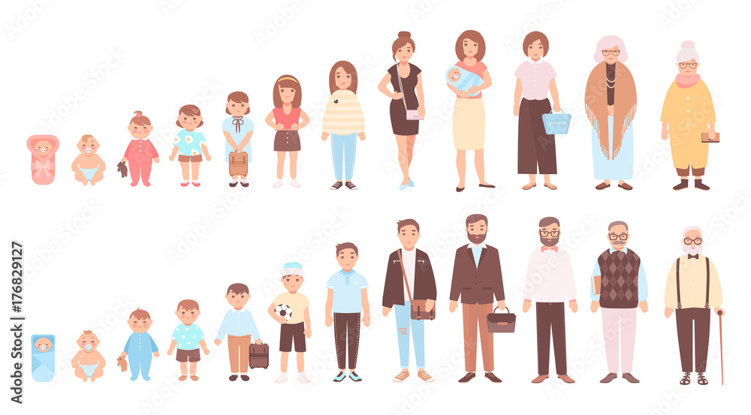
Animals including humans – Year 5
The human body as it develops into old age
Muscle mass decreases and muscles lose strength
Wrinkles develop on the skin
Hair begins to turn grey/white
Fertility decreases
People begin to shrink in height
Organs begin to lose their effectiveness
Senses become weaker
Puberty
In humans, puberty normally begins around age 11-12, however it can take place anytime from age 8-14. Puberty happens when the pituitary glands begin to release hormones.
Males | Females
Boys grow taller. They develop more muscle mass, and their chest and shoulders broaden. | Girls grow taller. They develop breasts and their hip bones widen. The body becomes curvier.
Boys’ voice become deeper. Their skin becomes oilier, meaning they may get spots. | Their skin becomes oilier, meaning they may get spots.
Hair begins to grow on their faces and bodies, including armpit and pubic hair. | Hair begins to grow on their bodies, including armpit and pubic hair.
Penis and testicles grow larger. The testicles begin to make millions of sperm. | Menstruation begins. Girls begin to have periods and their uterus (womb) begins to grow.
How a baby changes physically as it grows
Moves their head, holds their head up, reaches and grabs objects, rolls over, sits up, stands up, crawls, walks

