Slide 1
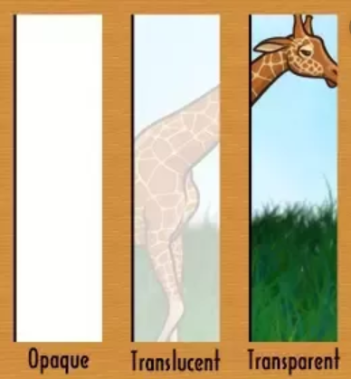
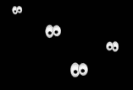
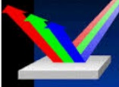
Light – Year 3
- Light is a form of energy that makes it possible to see.
Light is given off some objects (for example the Sun)
Darkness is when there is no light
- Light can reflect off surfaces (e.g. mirrors)
- Shadows are formed when light is blocked by an opaque object.
Transparent – allow all of the light to travel through
Translucent – only allow some light to travel through
Opaque – light is blocked
Dark Darkness is the absence of light Human vision is unable to see colours when there is no light At nighttime, the sky is darker because there is a lack of light from the sun
Reflection Light bounces off other objects, sending it in another direction Examples of materials that reflect light are mirrors and polished surfaces
Protection from sunlight
Some types of light, such as the sun, can be dangerous for our eyes and skin. This is because they contain UV rays that can cause damage.
Things we can do to protect
ourselves:
Wear sunglasses
Wear sun cream
Cover up with our clothes

Slide 2
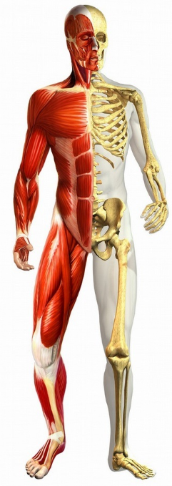
Animals including humans – Year 3
Nutrition
Humans and animals require certain types of nutrition to stay healthy.
The Human Body
Skeleton
Support the human body and give it shape
Help the body to move
Protect important parts of the body, such as organs like the heart and lungs
Muscles are attached to the skeleton
Muscles
Help the body to move
Maintain posture to help humans/animals sit, stand and walk
Some muscles move by themselves – they are involuntary
Carbohydrates Give the body energy Examples – pasta, rice, oats, bread
Protein Helps the body to repair itself Examples – meat, eggs and nuts | Fat Gives the body energy Examples – butter, cakes, fast food
Fibre Helps the human digestive system to work Examples – bread, cereal, potatoes | Vitamins and minerals Helps to generally keep the body healthy Examples – fruits and vegetables

Slide 3
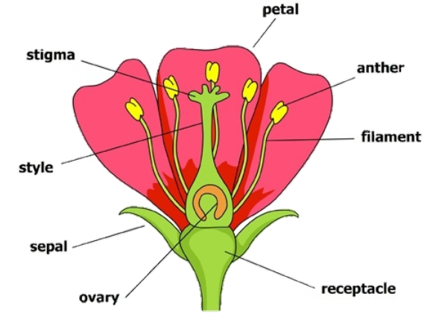
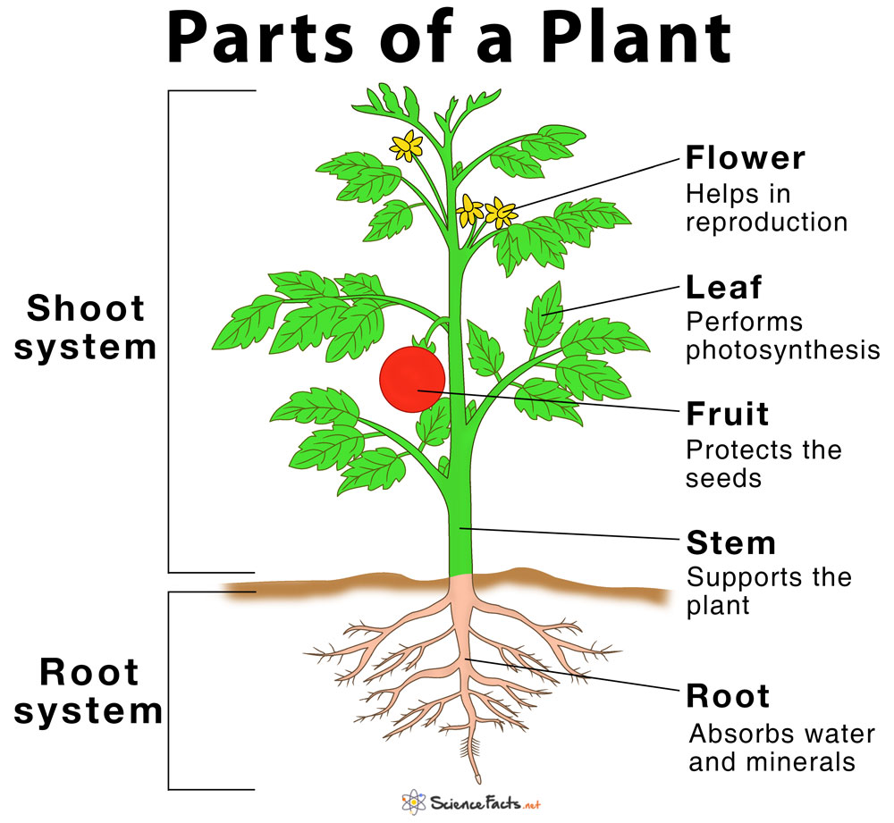
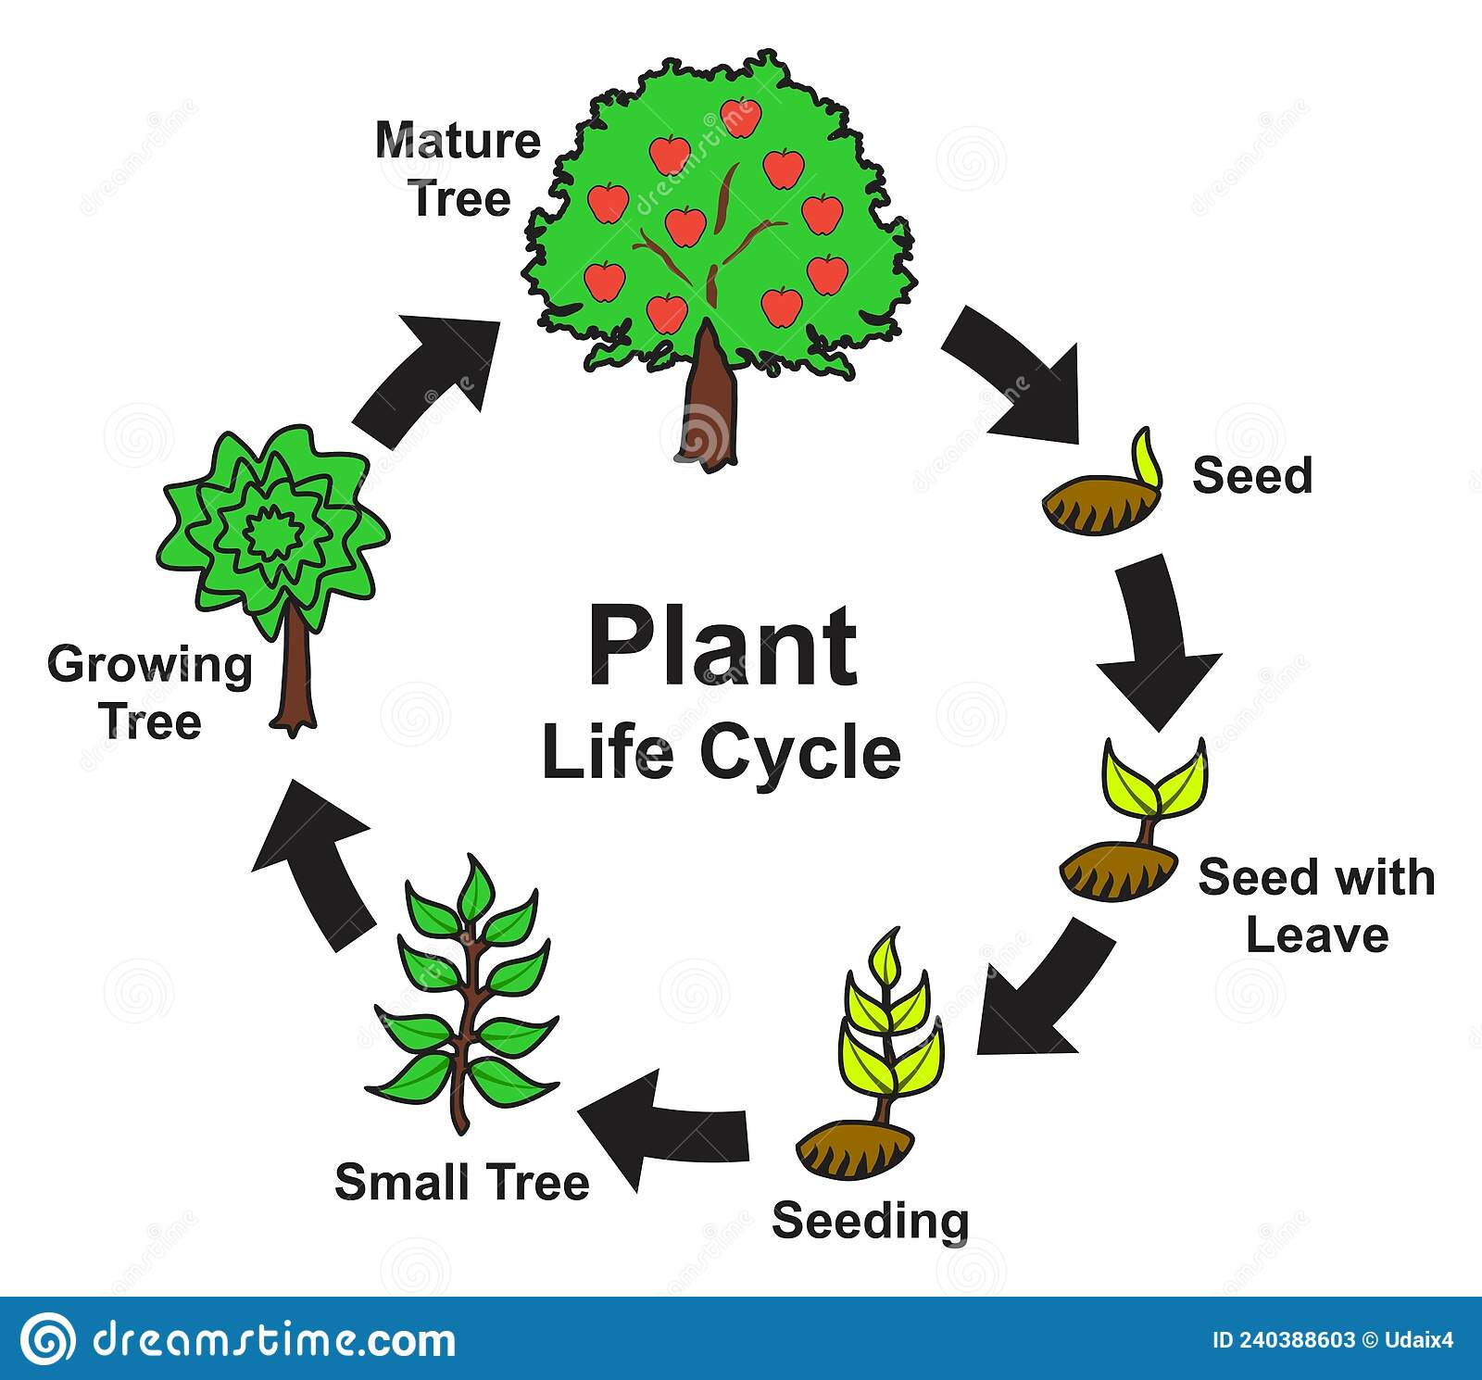
Plants – Year 3
Parts of a plant
Flowers play an important role in the reproduction of plants
Stamen (male part) – made up of a filament and an anther
Anther – contains pollen
Carpel (female part) – made up of a stigma, style and an ovary
When the stamen lands on the stigma, pollination occurs (a seed is produced)
Insects are drawn to flowers by bright petals and transfer the pollen to other plants
Requirements for plants to live and grow:
Air | Light
Water | Nutrients
Warmth | Space

Slide 4
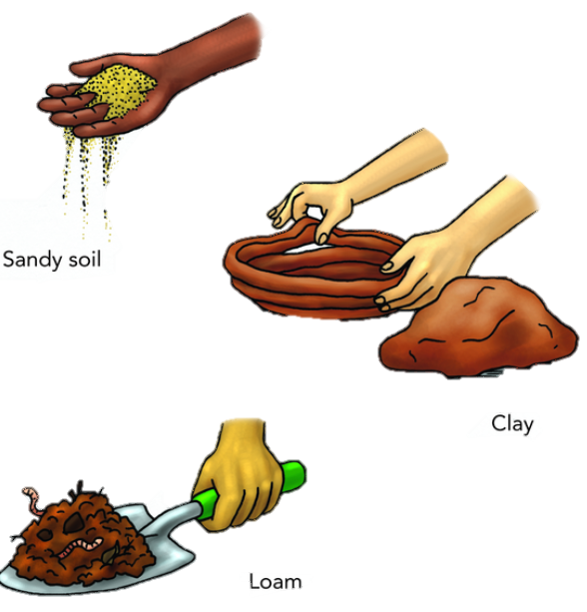
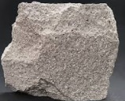
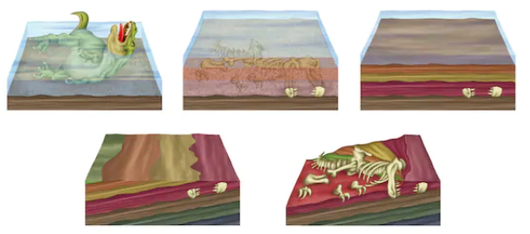
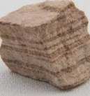
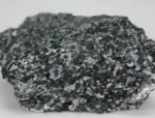
Rocks – Year 3
Classification of rocks
Igneous Formed from magma, a hot underground liquid Many igneous rocks are non-porous
Sedimentary Formed when small particles of mineral are washed down rivers or other bodies of water They are porous and can be easily warn down.
Metamorphic Formed when rock becomes warm enough to bend and mould. Can sometimes form interesting shapes They are normally non-porous.
Fossils
After an animal dies, the soft parts of their body decompose, leaving the hard things such as teeth and bones
The remains are buried by sediment
As more layers of sediment build on top, the sediment around the remains begins to harden into rock.
Water seeps through, dissolving the bones. Minerals then replace them, creating a rock replica of the bone – this is called a fossil.
Soil
Soil is a combination of a range of materials, including ground up pieces of rock, particles from dead plants and animals, air and soil.
Types of soil:
Sandy soil is dry soil with lots of air found in it.
Clay soil is sticky and doesn’t have much air in it. Clay soil often contains a lot of water.
Loam soil is somewhere between the two – it has some water in it and has a bit of air in it.
Loam soil is normally the best type of soil for growing plants in. If you dig through soil, you will find that there are different layers with different features

Slide 5
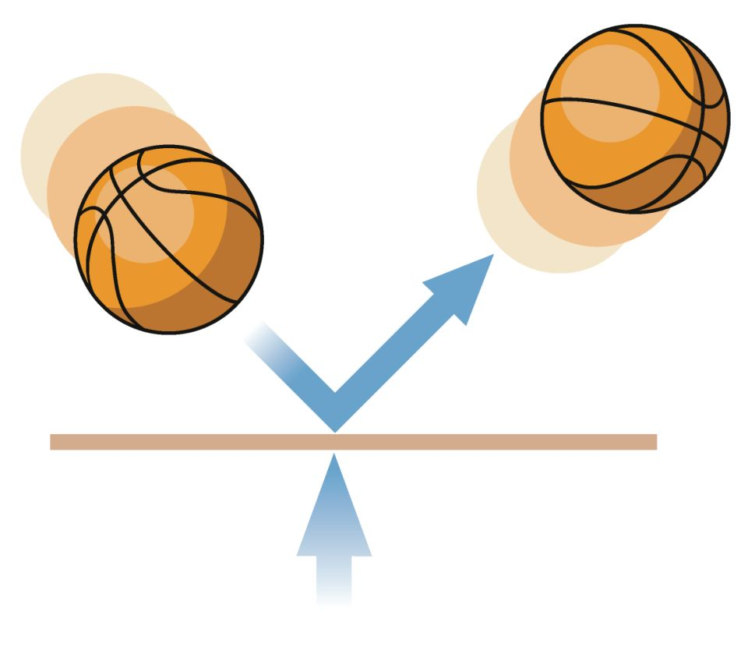
Forces – Year 3
Key vocabulary | Definition
Force | Pushes or pulls
Friction | A force that acts between two surfaces or objects that are moving across each other
Surface | The top layer of something
Magnet | An object that produces a magnetic force to pull things towards one another
Repel | Force that pushes objects away from one another
Attract | Force that pulls objects towards one another
Forces are shown by arrows in diagrams. The bigger the arrow, the bigger the force.
Magnetics that are the same repel
Magnetics that are opposite attract

