Slide 1

Year 2 C E W
Vocabulary Exploration

Slide 2
Please note;
Some of these words have multiple meanings and forms. Included in this presentation are the most commonly used word forms for Year 2.

Slide 3


Word | Meaning
after (preposition) | Doing something after an action or event.
In a Sentence | Drawing
After I brush my teeth, I go to bed.

Slide 4


Word | Meaning
again (adverb) | An action or event is being repeated.
In a Sentence | Drawing
It is raining again!

Slide 5
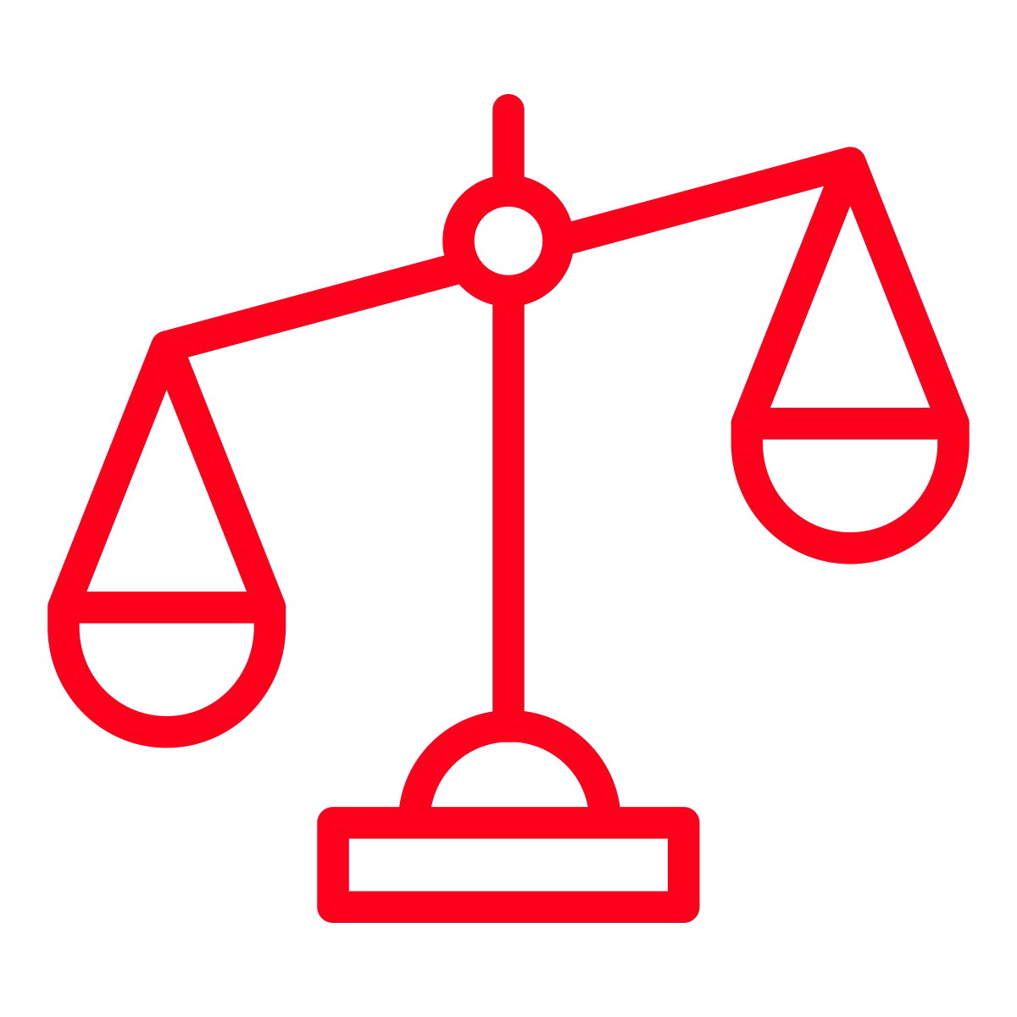

Word | Meaning
any (determiner) | Some of a thing or number of things, no matter how much or how many.
In a Sentence | Drawing
Have you got any sweets?

Slide 6
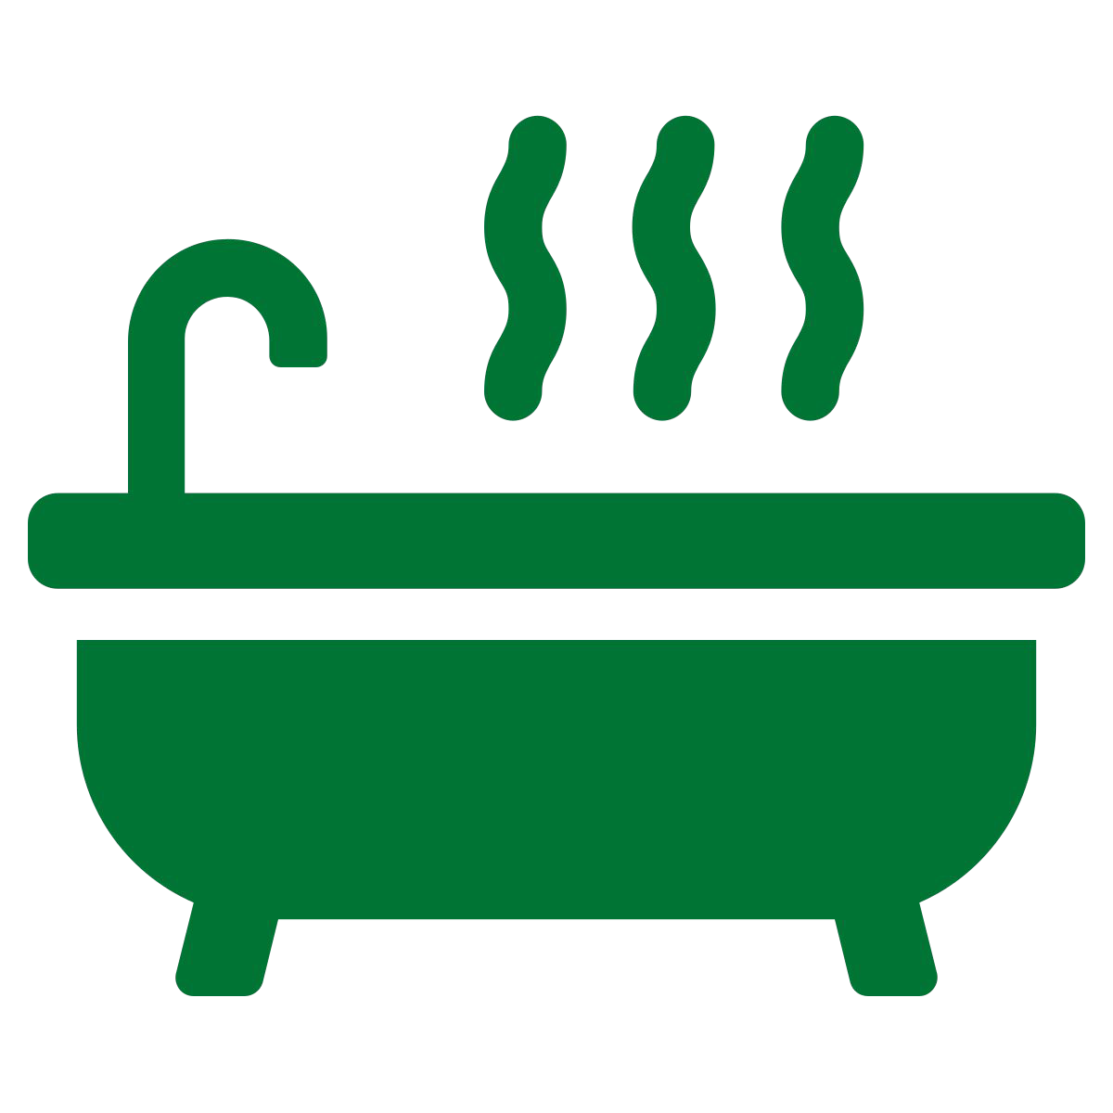
Word | Meaning
bath (noun) | A container that you fill with water to wash your body.
In a Sentence | Drawing
It is time for my hot bath.

Slide 7


Word | Meaning
beautiful (adjective) | Something is very good looking or attractive.
In a Sentence | Drawing
Look at that beautiful butterfly.

Slide 8


Word | Meaning
because (conjunction) | Explaining the reason for something.
In a Sentence | Drawing
I want some food, because I am hungry.

Slide 9


Word | Meaning
behind (preposition) | Something is nearer their back rather than the front.
In a Sentence | Drawing
The noisy dog was running behind me.

Slide 10
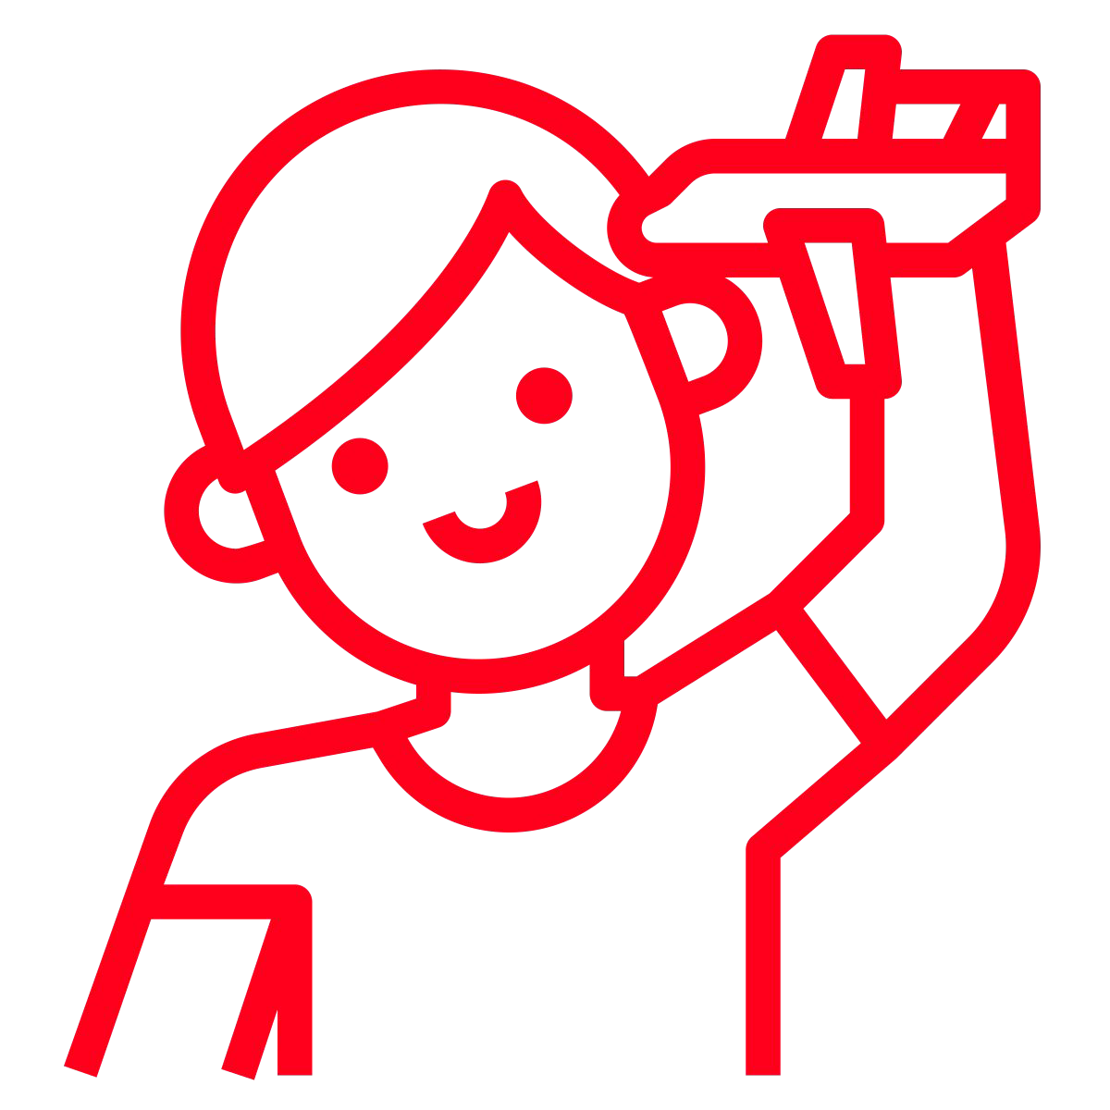
Word | Meaning
child (noun) | Not yet an adult.
In a Sentence | Drawing
My child loves aeroplanes!

Slide 11
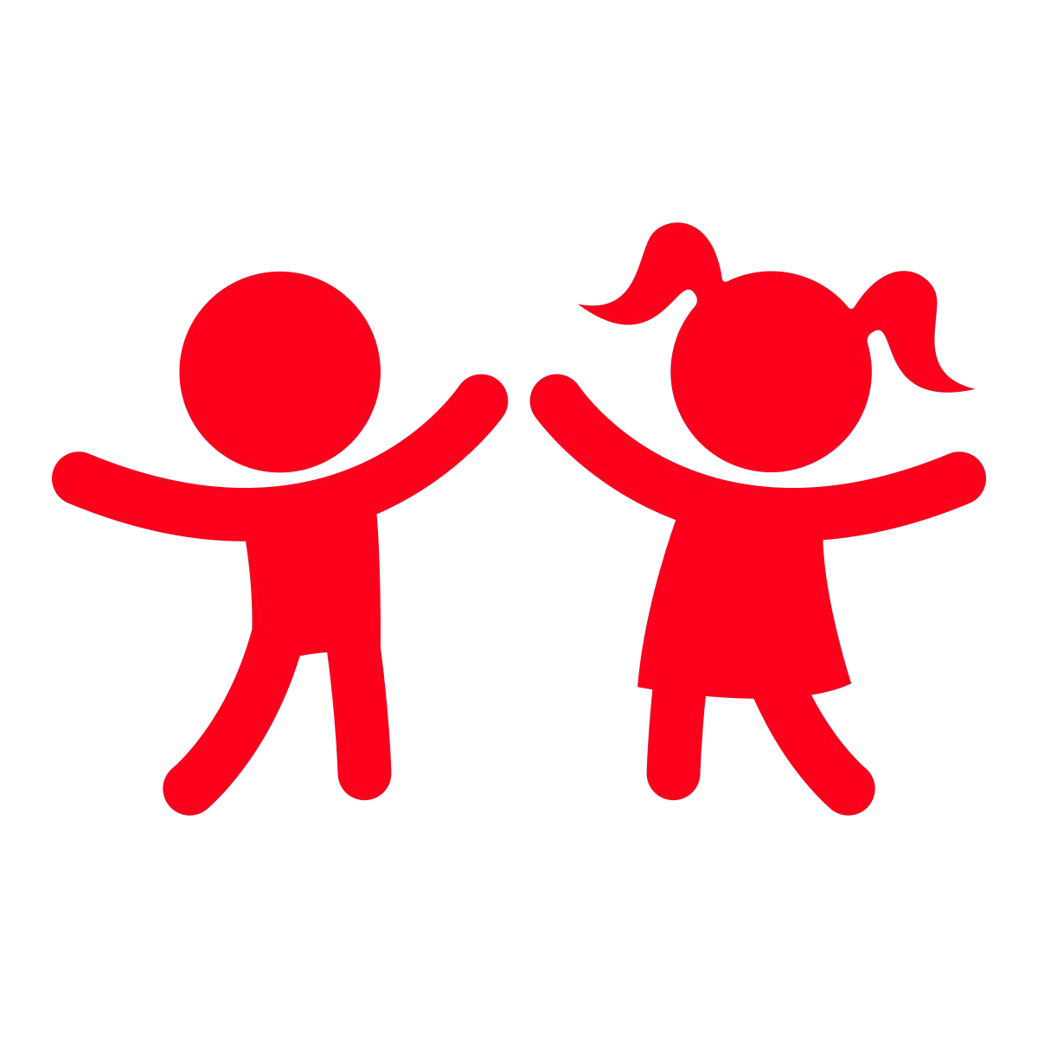
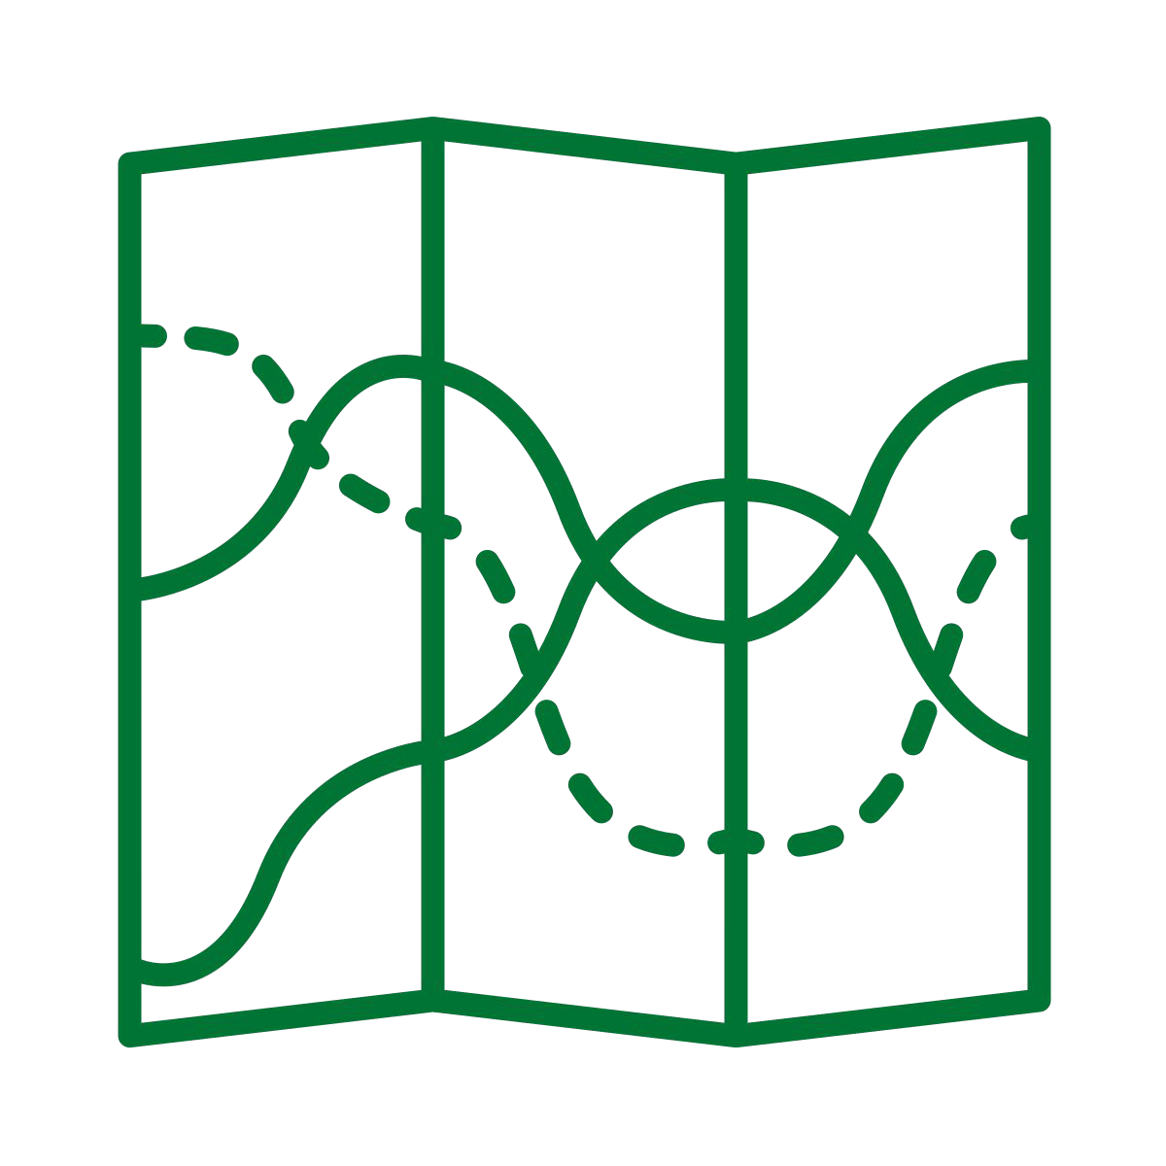
Word | Meaning
children (noun) | More than one child (plural)
In a Sentence | Drawing
The children were keen to go on an adventure.

Slide 12
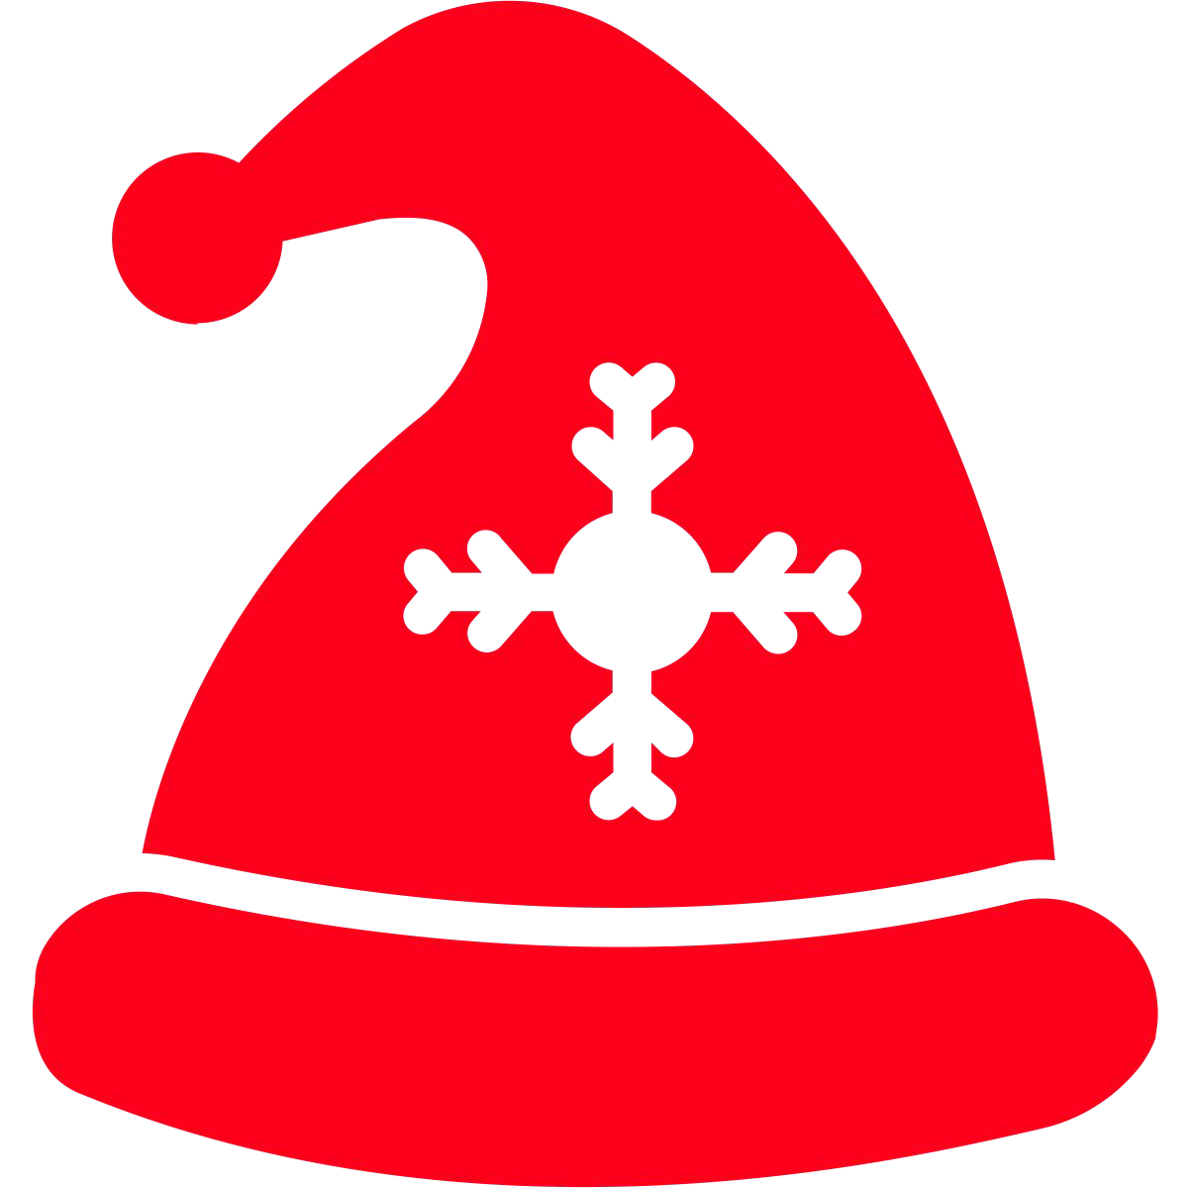

Word | Meaning
Christmas (noun) | A Christian festival when the birth of Jesus Christ is celebrated. Christmas is celebrated on the 25th of December.
In a Sentence | Drawing
I wish it could be Christmas everyday.

Slide 13
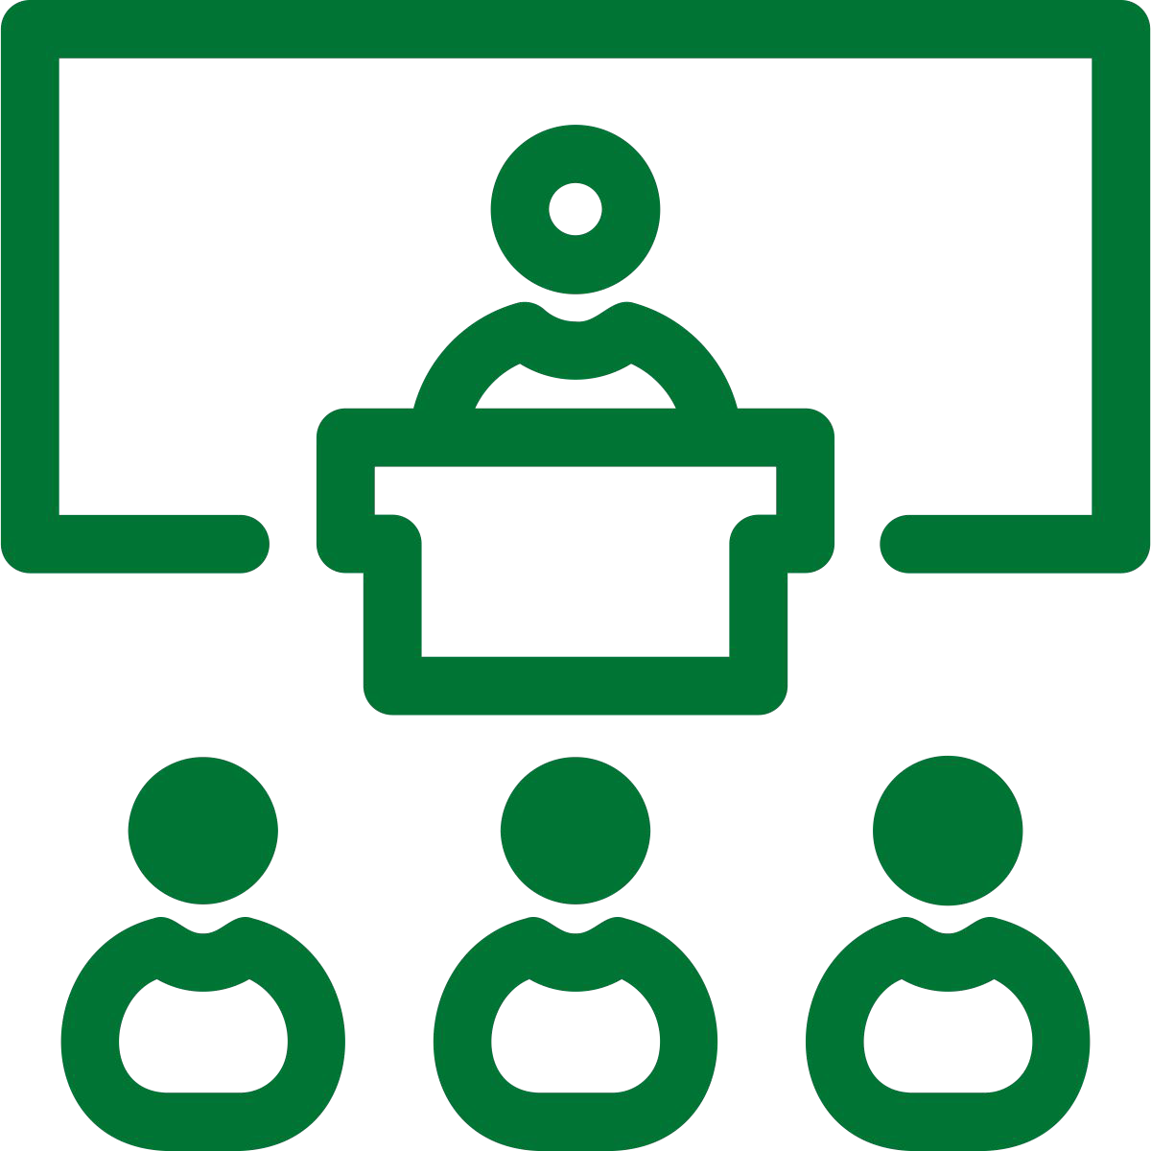
Word | Meaning
class (noun) | Group of people who are taught together.
In a Sentence | Drawing
I have made three new friends in my class.

Slide 14
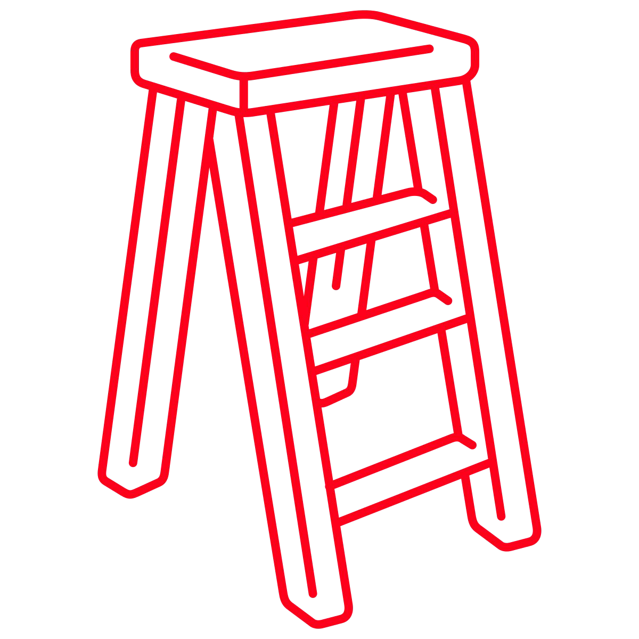
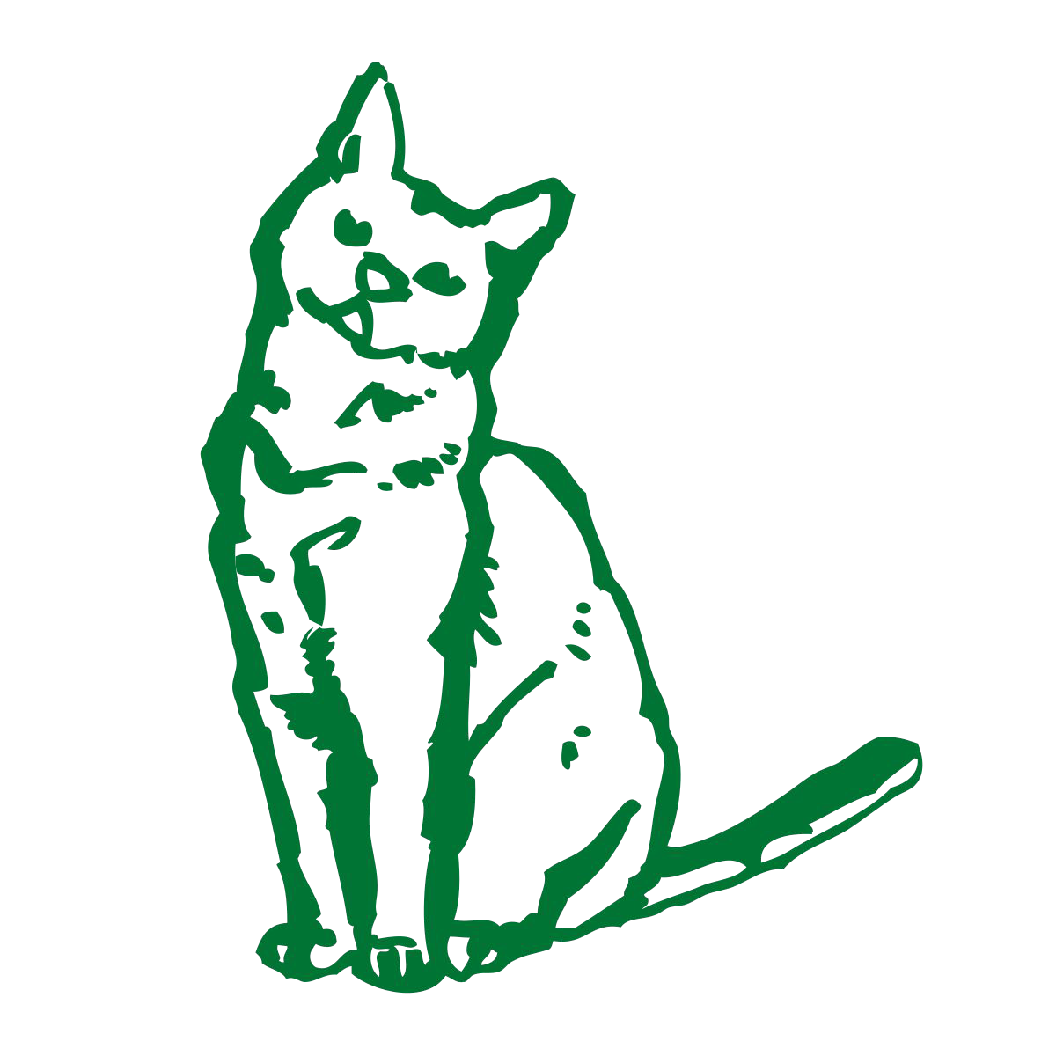
Word | Meaning
climb (verb) | Moving up or down towards something.
In a Sentence | Drawing
To save the cat, I need to climb the ladder.

Slide 15
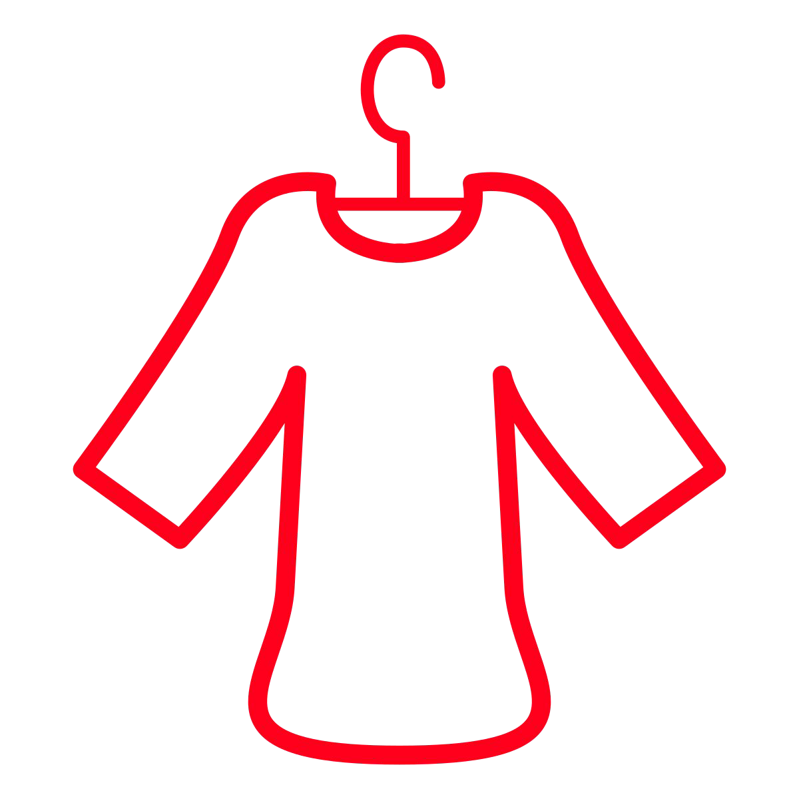

Word | Meaning
clothes (noun) | Clothes are the things that people wear, such as shirts, coats, trousers, and dresses.
In a Sentence | Drawing
I have bought some new clothes today.

Slide 16
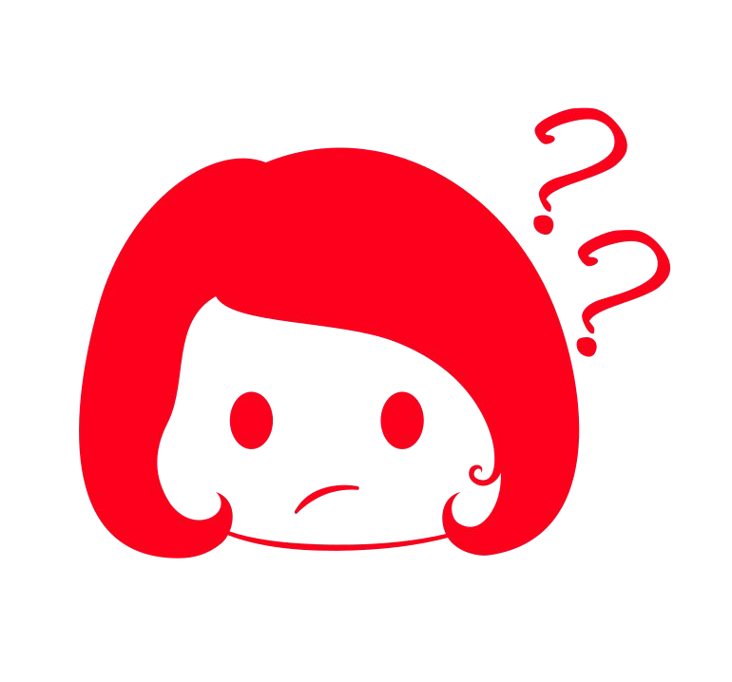

Word | Meaning
could (modal verb) | Saying something is a possibility. Someone had the ability to do something.
In a Sentence | Drawing
It could rain today, but I am not certain.

Slide 17
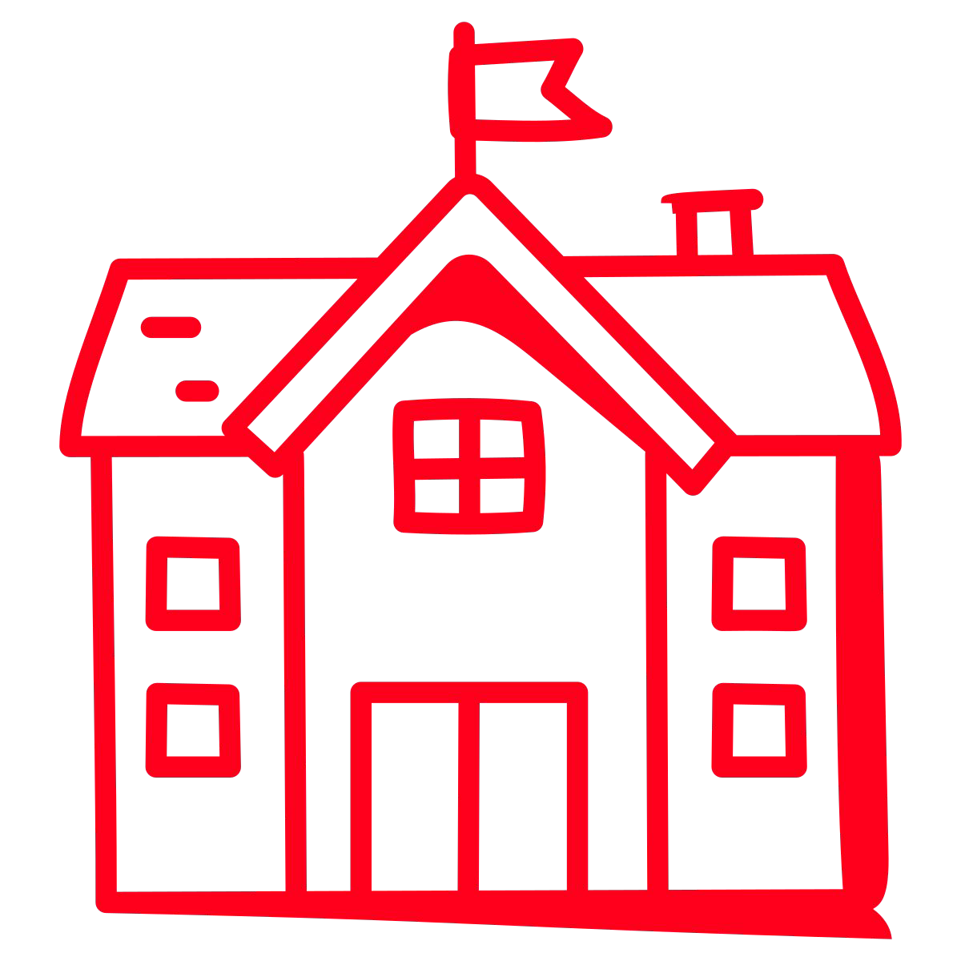

Word | Meaning
every (determiner) | Talking about all the members of a group or all the parts of something and not only some of them.
In a Sentence | Drawing
Every school has a playground.

Slide 18

Word | Meaning
everybody (pronoun) | All people within a group.
In a Sentence | Drawing
I have asked everybody to line up silently.

Slide 19

Word | Meaning
eye(s) (noun) | Your eyes are the parts of your body with which you see.
In a Sentence | Drawing
He has lovely, blue eyes!

Slide 20

Word | Meaning
fast (adjective) | Fast means happening, moving, or doing something at great speed.
In a Sentence | Drawing
I am driving my car really fast.

Slide 21
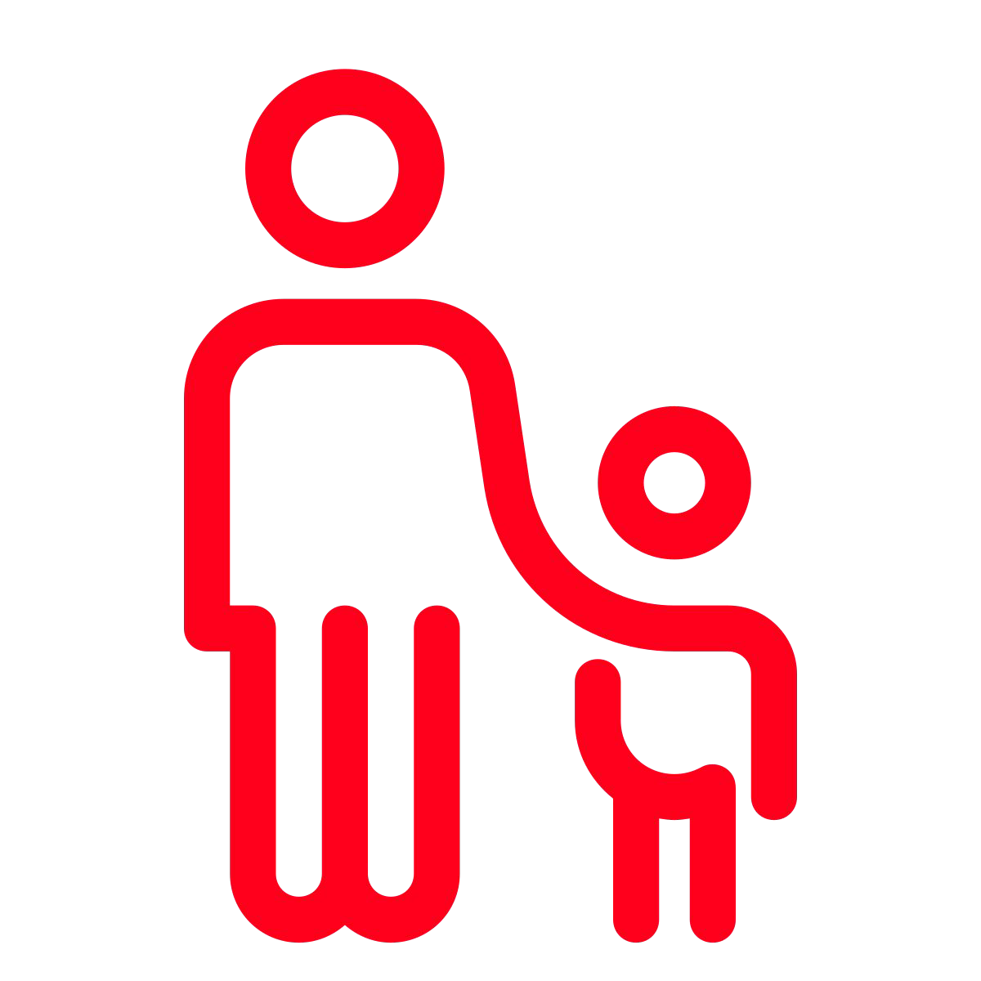
Word | Meaning
father (noun) | Your father is your male parent (dad).
In a Sentence | Drawing
My father was proud of me.

Slide 22


Word | Meaning
find (verb) | If you find someone or something, you see them or learn where they are.
In a Sentence | Drawing
I need to find my football.

Slide 23


Word | Meaning
floor (noun) | The floor of a room is the part of it that you walk on.
In a Sentence | Drawing
Oh no! I dropped my lunch all over the floor.

Slide 24
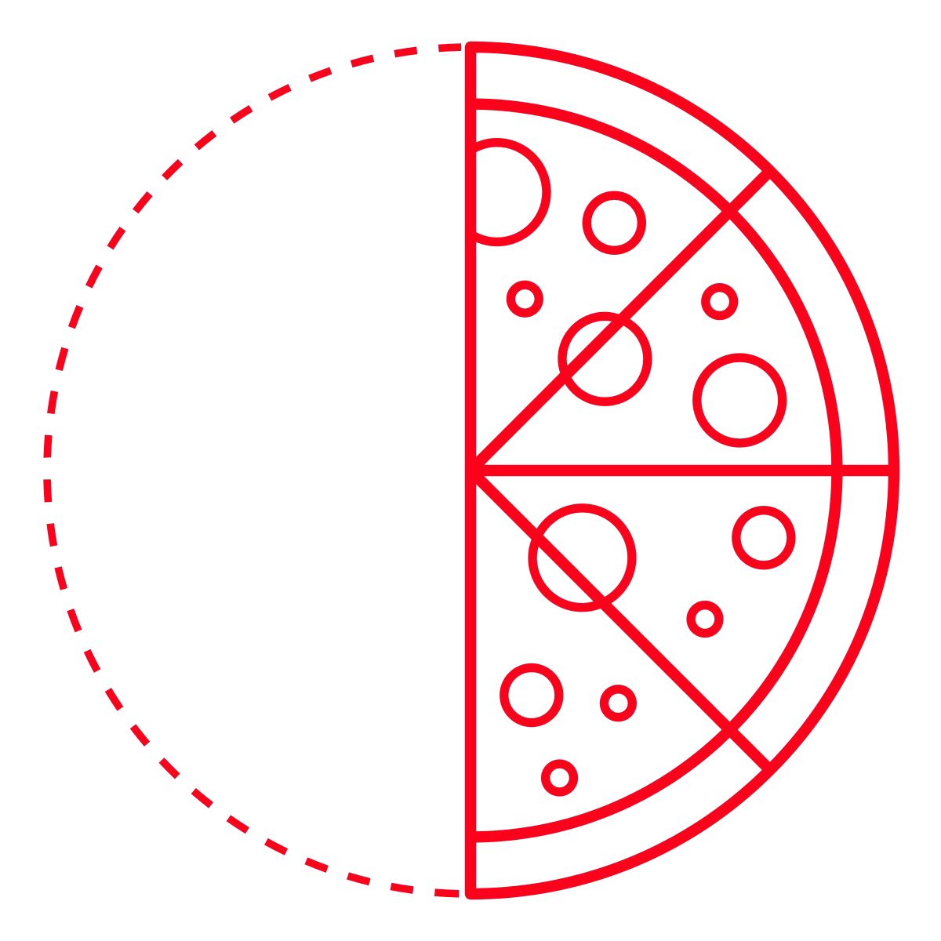
Word | Meaning
half (fraction) | Half of an amount or object is one of two equal parts that together make up the whole number, amount, or object.
In a Sentence | Drawing
I will eat half of my pizza now.

Slide 25
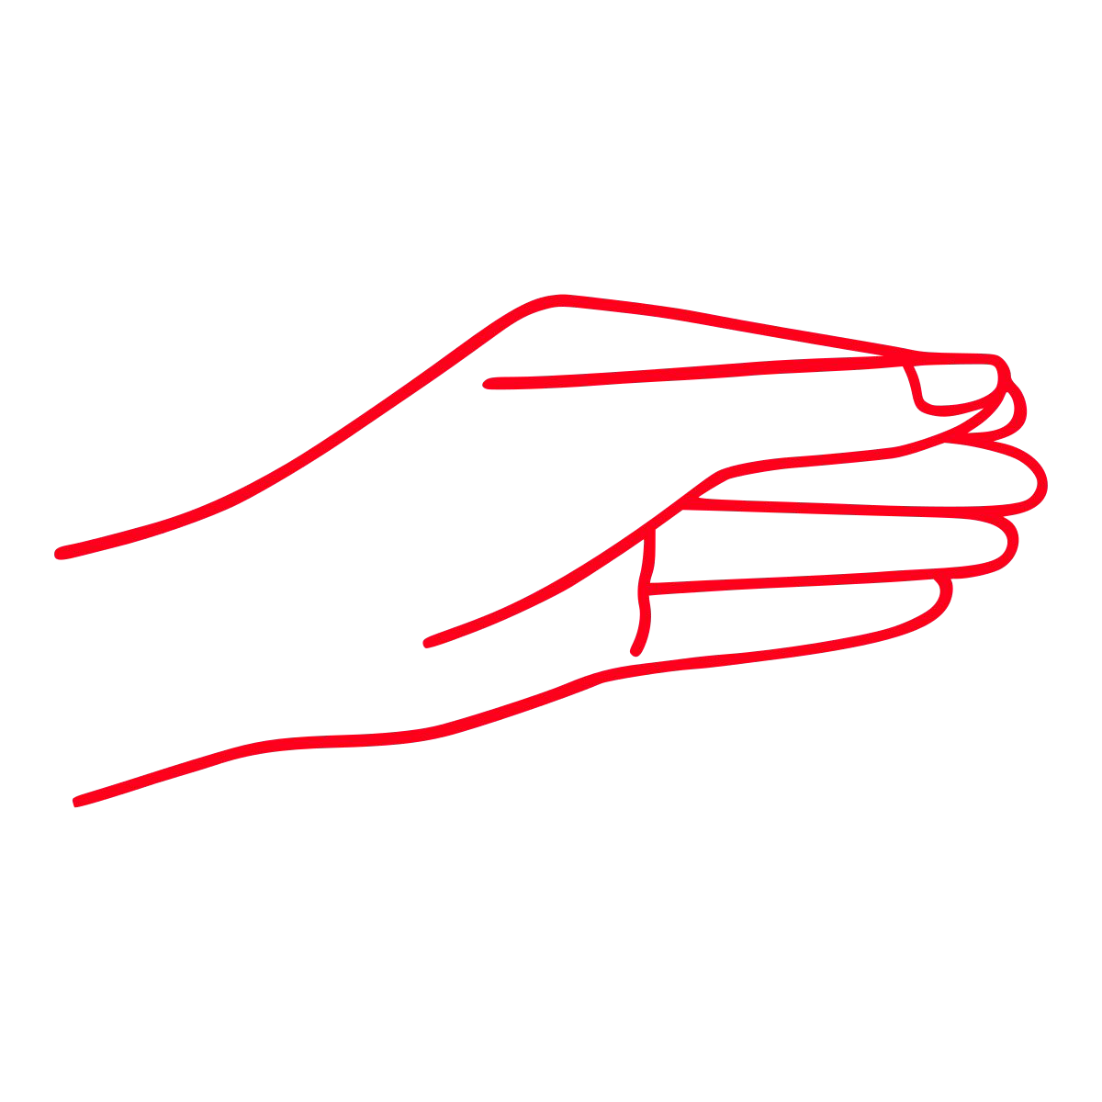

Word | Meaning
hold (verb) | When you hold something, you carry or support it, using your hands or your arms.
In a Sentence | Drawing
Please hold your pencil properly.

Slide 26


Word | Meaning
hour (noun) | An hour is a period of sixty minutes.
In a Sentence | Drawing
I have been reading for one hour.

Slide 27


Word | Meaning
improve (verb) | If something improves or if you improve it, it gets better.
In a Sentence | Drawing
I need to improve my handwriting.

Slide 28

Word | Meaning
kind (adjective) | Someone who is kind behaves in a gentle, caring, and helpful way towards other people.
In a Sentence | Drawing
My friend is really kind to me.

Slide 29
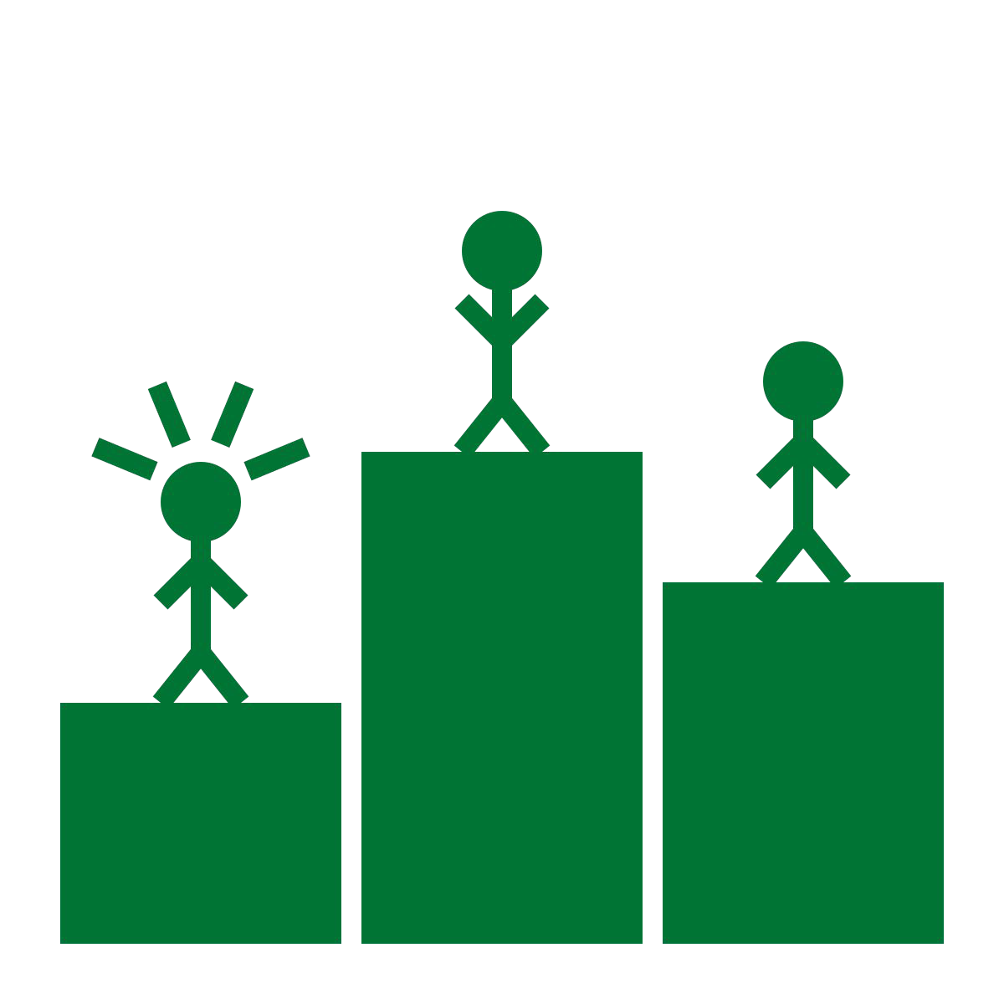
Word | Meaning
last (adjective, ordinal number) | Adjective - The last event, person, thing, or period of time is the most recent one. Ordinal Number - The one that happens or comes after all the others of the same kind.
In a Sentence | Drawing
Adjective - The last few weeks have been great. Ordinal Number - I came last in the running race.

Slide 30

Word | Meaning
many (determiner) | You use many to indicate that you are talking about a large number of people or things.
In a Sentence | Drawing
I have read many books this summer.

Slide 31

Word | Meaning
move (verb) | When you move something or when it moves, its position changes and it does not remain still.
In a Sentence | Drawing
Please move out of the way.

Slide 32

Word | Meaning
Mr (title noun) | Mr is used before a man's name when you are speaking or referring to him.
In a Sentence | Drawing
My teacher is called Mr Plant.

Slide 33

Word | Meaning
Mrs (title noun) | Mrs is used before the name of a married woman.
In a Sentence | Drawing
My teacher is called Mrs Plant.

Slide 34
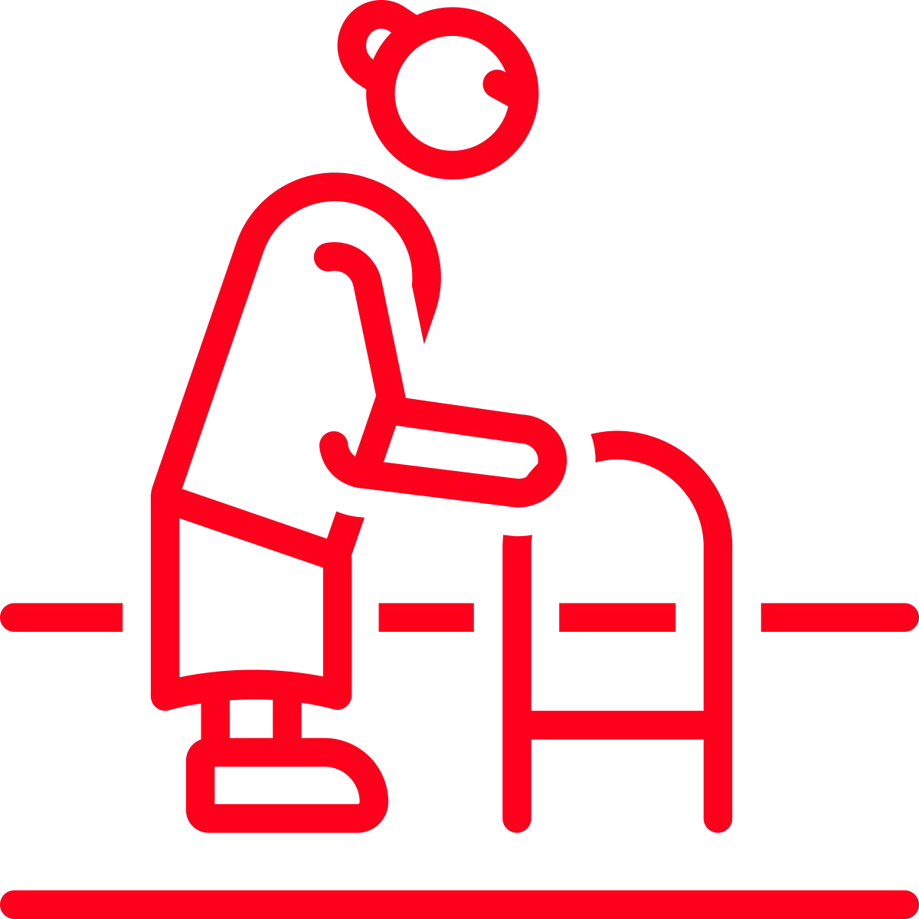
Word | Meaning
old (adjective) | Something that is old has existed for a long time.
In a Sentence | Drawing
I grandma is very old!

Slide 35

Word | Meaning
only (adjective) | If you talk about the only thing involved in a particular situation, you mean there are no others involved in it.
In a Sentence | Drawing
There is only one chocolate left in the box.

Slide 36

Word | Meaning
parents (noun) | Your parents are your legal guardians who look after you.
In a Sentence | Drawing
My parents are the best!

Slide 37
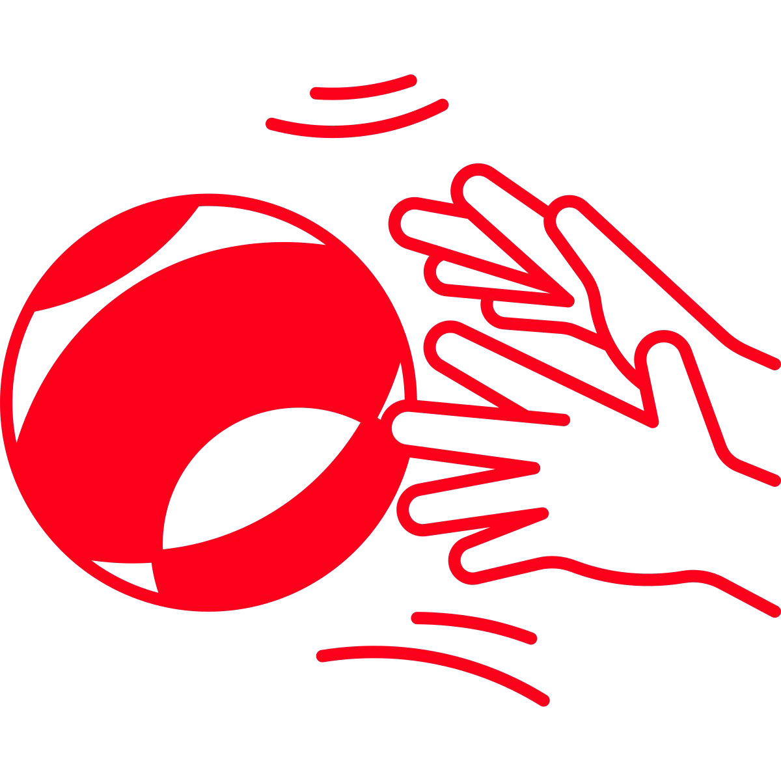
Word | Meaning
pass (verb) | To pass someone or something means to go past them without stopping.
In a Sentence | Drawing
Pass me the ball!

Slide 38
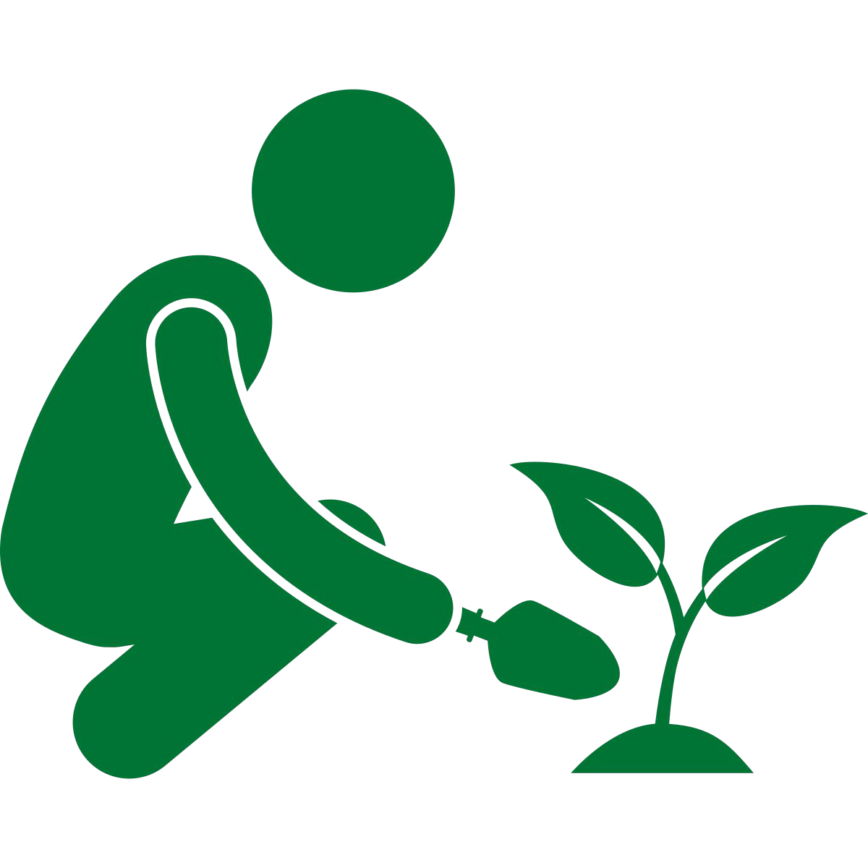
Word | Meaning
plant (noun, verb) | Noun - A plant is a living thing that grows in the earth and has a stem, leaves, and roots. Verb - When you plant a seed, plant, or young tree, you put it into the ground so that it will grow there.
In a Sentence | Drawing
Noun - This tropical plant is lovely. Verb - Let’s plant a tree!

Slide 39

Word | Meaning
poor (adjective) | Has very little money and few possessions.
In a Sentence | Drawing
Oliver Twist came from poor family.

Slide 40
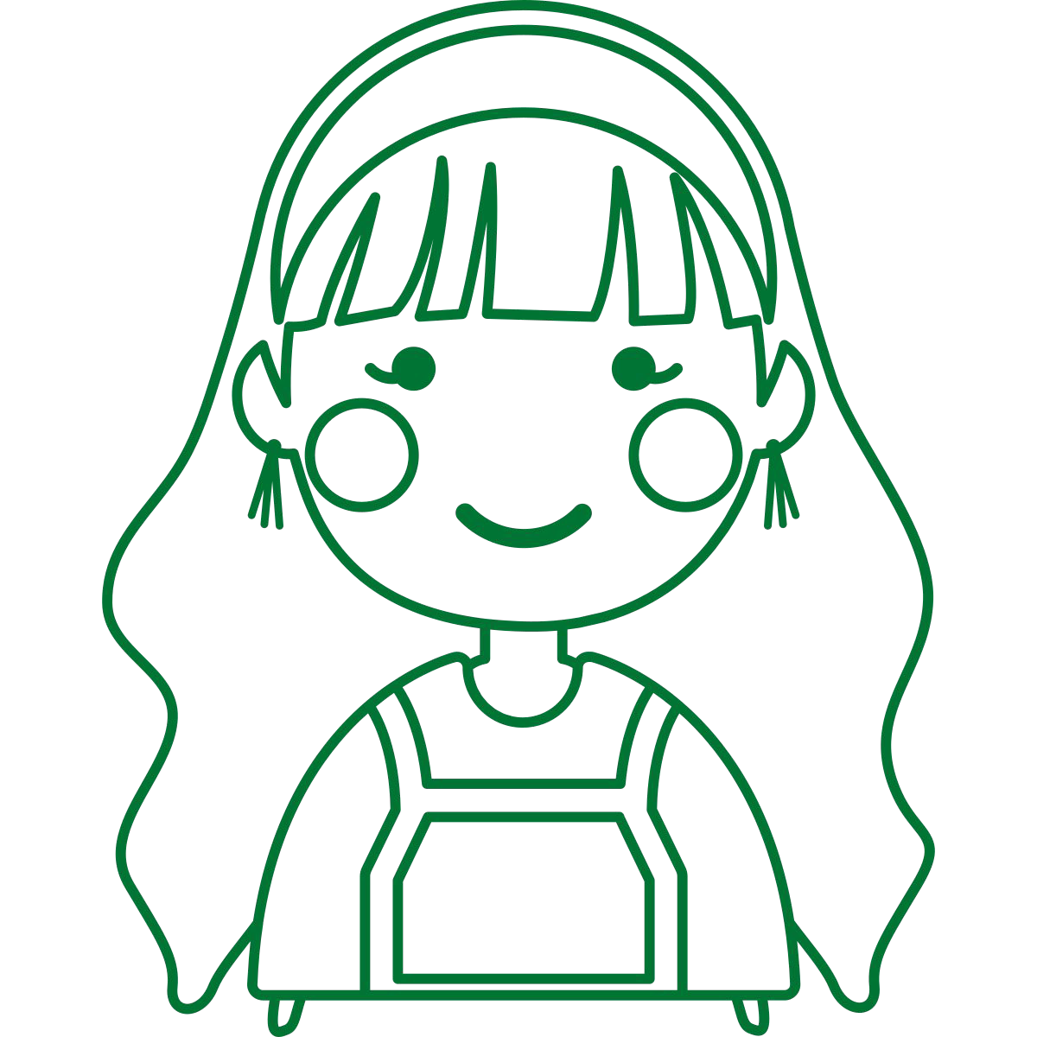
Word | Meaning
pretty (adjective) | If you describe someone as pretty, you mean that they are attractive.
In a Sentence | Drawing
My doll is so pretty.

Slide 41

Word | Meaning
prove (verb) | If you prove that something is true, you show evidence that it is definitely true.
In a Sentence | Drawing
Prove this answer is correct.

Slide 42


Word | Meaning
should (modal verb) | You use should when you are saying what would be the right thing to do or the right state for something to be in.
In a Sentence | Drawing
I should read more at home.

Slide 43

Word | Meaning
steak (noun) | A steak is a large flat piece of beef. You cook it by grilling or frying it.
In a Sentence | Drawing
My steak is delicious.

Slide 44


Word | Meaning
sugar (noun) | Sugar is a sweet substance that is used to make food and drinks sweet. It is usually in the form of small white or brown crystals.
In a Sentence | Drawing
Milk chocolate is full of sugar.

Slide 45

Word | Meaning
whole (quantifier) | If you refer to the whole of something, you mean all of it.
In a Sentence | Drawing
I ate the whole box of sweets…oops!

Slide 46

Word | Meaning
who (pronoun) | You use who in questions when you ask about the name or identity of a person or group of people.
In a Sentence | Drawing
Who is your best friend?

Slide 47

Word | Meaning
wild (adjective) | Wild animals or plants live or grow in natural surroundings and are not looked after by people.
In a Sentence | Drawing
We saw two wild bears in the forest.

Slide 48


Word | Meaning
would (modal verb) | You use would, usually in questions with 'like', when you are making a polite offer or invitation.
In a Sentence | Drawing
Would you pass me a drink?

