Slide 1
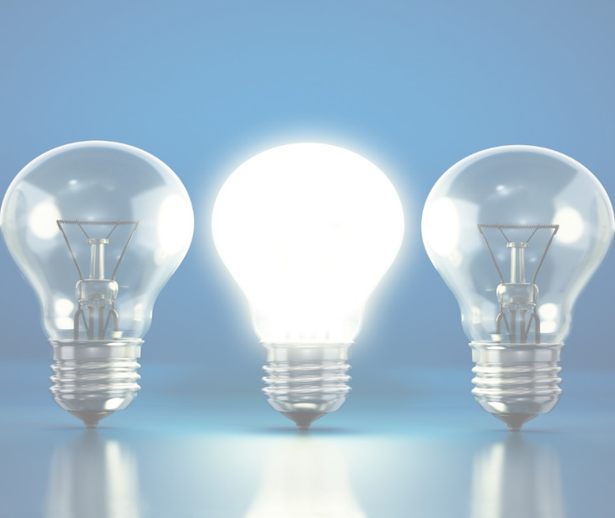
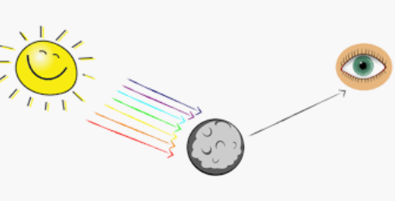
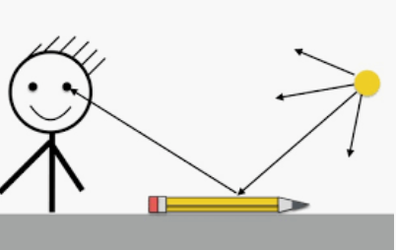
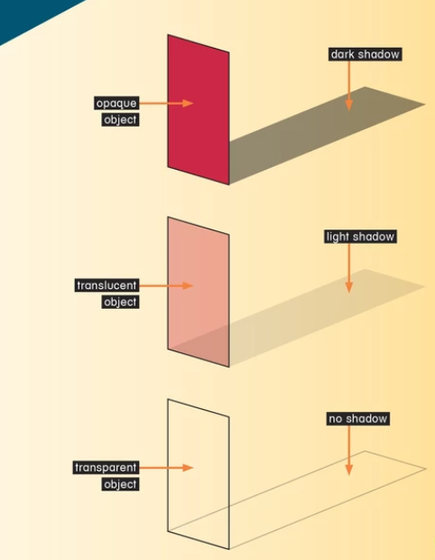
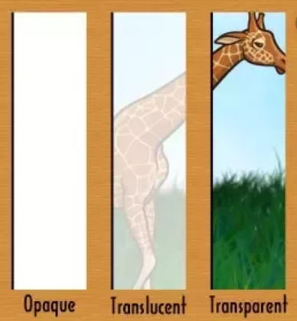
Light – Year 6
Light is a form of energy that makes it possible to see.
Light is given off some objects (for example the Sun). Darkness is the absence of light.
Light can reflect off surfaces (e.g. mirrors). Light is absorbed by other materials.
Objects can be labelled as transparent, translucent, or opaque, depending on the amount of light that they let through.
Shadows are formed when light is blocked by an opaque object.
How light travels
Lights comes from light sources
Light travels in a straight line
When an object passes in front of a ray of light, the light can be blocked, creating a shadow.
Transparent – allow all of the light to travel through
Translucent – only allow some light to travel through
Opaque – light is blocked
We see things because:
Light is reflected from a light source into our eyes
When the light enters our eyes, we see the object.
The Moon is not luminous (does not produce its own light). We see it because light from The Sun reflects off it into our eyes.
After light reflects off objects, it continues to travel in a straight line, but in a new direction.

Slide 2
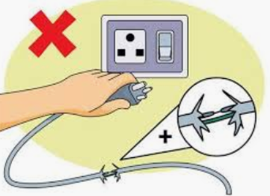
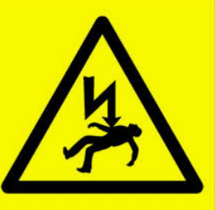
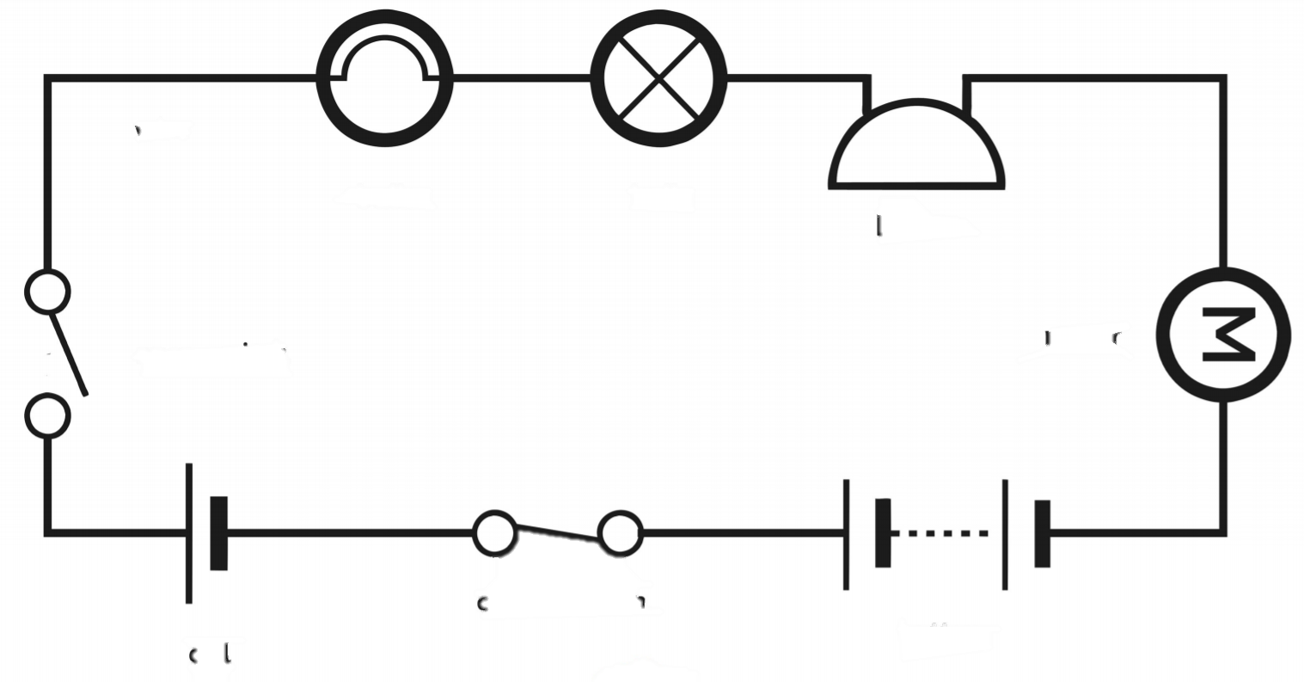
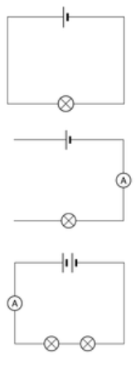
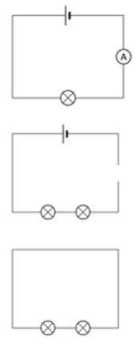
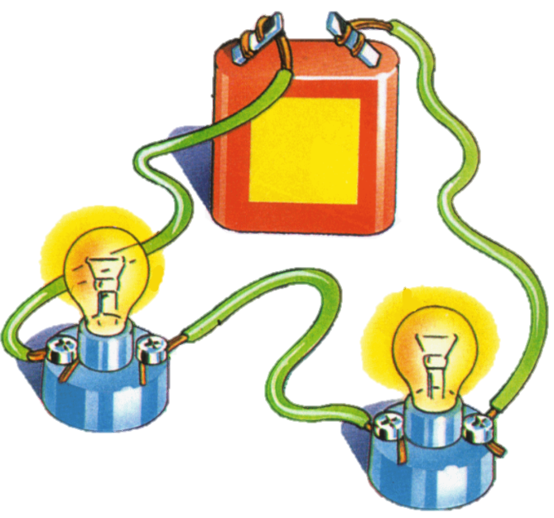
Electricity – Year 6
Electricity is a type of energy.
It is used to power lots of different things, including many items that we use in everyday life.
Electricity can flow through wires and cables and can be stored in batteries (sometimes called cells).
Electricity can flow in simple series electrical circuits.
Some materials conduct electricity, and others do not (insulators).
Electrical safety
Electricity can be extremely dangerous is it is not used safely.
Important electrical safety tips:
Do not put fingers and other objects in outlet
Never use anything with a cord or plug around water
Keep metal objects away from toasters
Stay away from power stations and lines
Never pull a plug out by its cord
Go indoors when it is thunder and lightning
Circuit diagrams
Key Vocabulary
Circuit
Complete
Diagram
Symbol
Cell
Battery
Bulb
Buzzer
Motor
Switch
Voltage
When drawing electrical circuits, you should use the standard symbols to show the different component
When changes are made to circuits, components can function differently

Slide 3
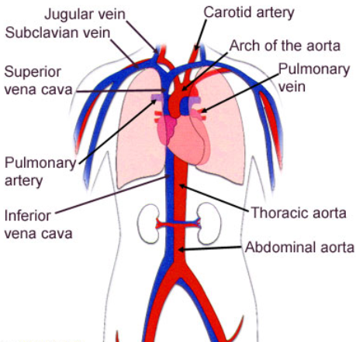
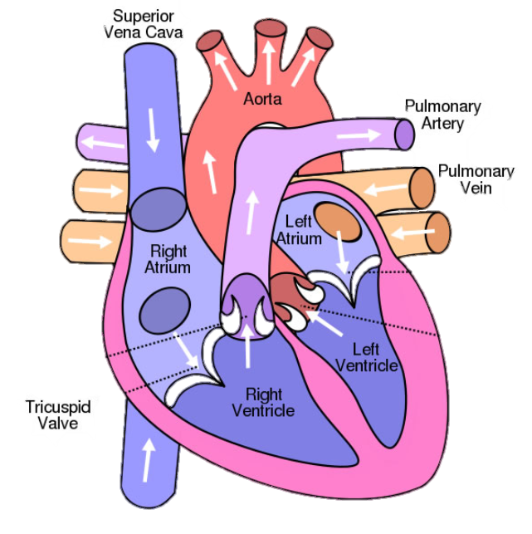
Animals including humans – Year 6
The circulatory system
The circulatory system is your body’s delivery system. It is made up of your heart, blood and blood vessels.
-The human body needs a constant supply of blood to keep working. Blood delivers oxygen to all of the body’s cells. The circulatory system transports blood (and the oxygen) around your body.
-The heart pumps blood to the lungs via the pulmonary artery, where it picks up oxygen. It is then returned to the heart through the pulmonary vein.
-The heart then pumps the oxygenated blood to the rest of the body through the aorta and the other arteries.
-Veins are vessels that bring blood back to the heart.
The circulatory system is centred on the heart, an organ that works constantly to pump blood around the body.
The heart is made up of four sections, called chambers:
Left atrium | Receives blood from the lungs
Right atrium | Receives blood from the rest of the body
Left ventricle | Pushes blood to the lungs
Right ventricle | Pushes blood to the rest of the body

Slide 4
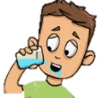
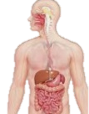
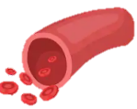
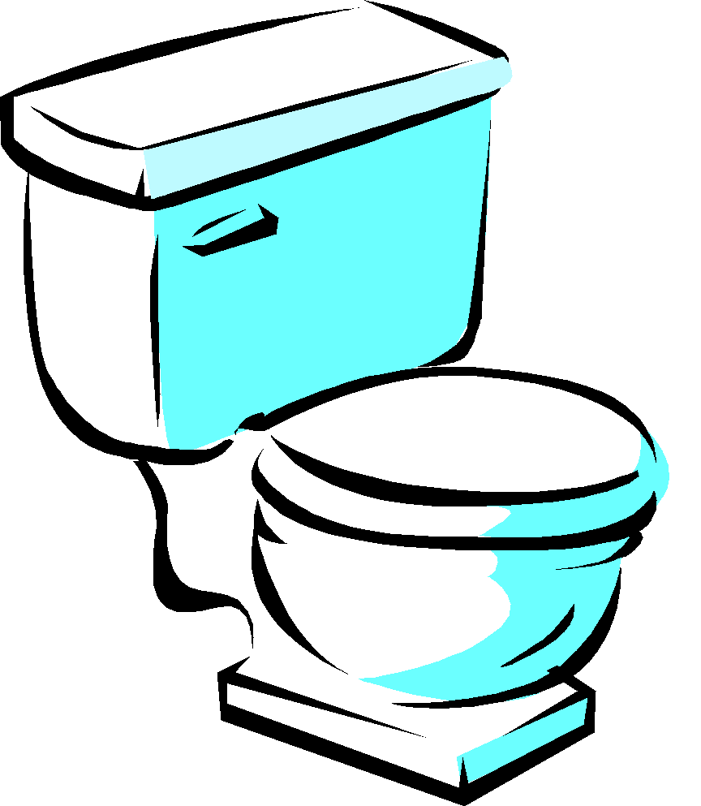
Animals including humans – Year 6
Impact of Diet, Exercise, and Drugs
Diet -A healthy, balanced diet can have a huge effect on a person’s health. People who eat the right balance of fresh, healthy foods are less prone to chronic illnesses and diseases. -Carbohydrates are used by the body to create glucose, the body’s main energy source. Fat is also helpful for energy, but too much fat in a person’s diet causes them to gain weight. Protein helps to build and repair muscles, but too much can cause indigestion and intestinal problems.
Exercise -As we exercise, our muscles need more oxygen. So, we breathe quicker, helping our lungs to take in more oxygen. -Our heart needs to pump blood more quickly to get all of the oxygen around the body. In order to do this, our heart rate increases. -Regular exercise helps our bones and muscles to become stronger. It also helps the heart and lungs to become healthier. | Drugs -A drug is a chemical that has an effect on your body. -Some drugs are prescribed by doctors to make people healthy. Other, illegal drugs can have a dangerous effect on our health. -Alcohol is a depressant. Alcohol can cause damage to the liver and brain. Cigarettes contain nicotine, which is a stimulant, and is addictive. Cigarettes cause damage to the lungs and heart.
Transportation of water and other nutrients
Rehydration – water is drunk through the mouth.
Absorption – water is absorbed by the intestines and is carried in the bloodstream.
Transportation – water is taken in blood to different parts of the body.
Excretion – waste water is passed out as urine.

Slide 5
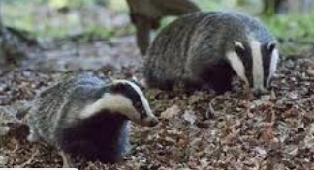
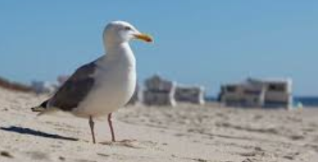
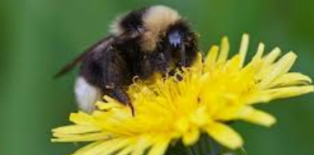
Living things and their habitats – Year 6
Animals and plants can be classified into different groups based on their characteristics.
Animals can be grouped into vertebrates (with a backbone) and invertebrates (without a backbone).
Plants are commonly grouped into flowering plants and non-flowering plants. They too can be sub-divided beyond these broad classifications
Classification of Animals
Classification of Habitats
Examples of animal groups:
Examples of habitats:
Mammals -Mammals are warm-blooded. -They often have hair/fur on their bodies. -Mammals give birth to live young. -Mammals often drink milk from their mothers.
Reptiles -Reptiles are cold-blooded. -They normally lay eggs (but some don’t). -Reptiles have scales or scutes.
Amphibians -Amphibians are cold-blooded animals. -They have moist, scaleless skin. It is often permeable. -Amphibians lay eggs.
M-R-S G-R-E-N
You can remember the seven features of living things by using the acronym MRS GREN (Movement, Respiration, Sensitivity, Growth, Reproduction, Excretion and Nutrition.
Forest
Seaside
Garden

Slide 6
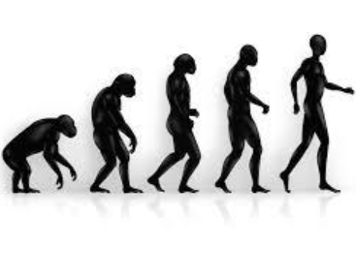
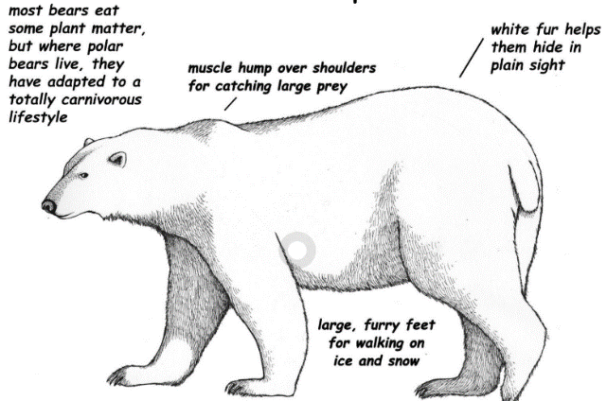
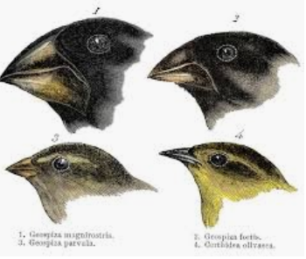
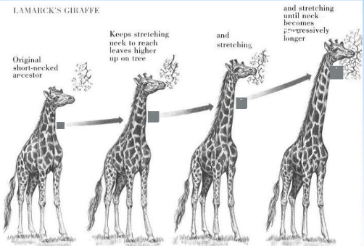
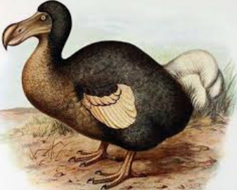
Evolution and Inheritance – Year 6
Evolution is the name given to changes that happen to a species over time.
Characteristics are passed from parents to their offspring. This is called inheritance.
Fossils are remains of living things and provide evidence about living things from the past.
Evidence of Evolution When paleontologists compare animals in fossils to animals today, they can see similarities and differences between them. e.g. Fossils show that giraffes necks did not used to be as long. They have developed over time to reach high branches. Living things also provide evidence of natural selection and evolution. e.g. On the Galapagos Islands, Charles Darwin found differences between finches from island to island. They had adapted for the different foods that they eat | Inheritance and mutation Living things produce offspring of the same kind. Some of a parent’s characteristics are passed down to the offspring – this is called inheritance. This is why we often share similar features with our parents. Inheritance is genetic, not environmental. Some features are new to the offspring. These are called mutations. This is why we are not exact copies of our parents. These changes in offspring over time allow evolution to take place.
 | Adaptation Natural selection can ensure that, over time, the advantageous characteristics survive in the species. For example, many polar animals have adapted to possess layers of blubber and/or fur (for warmth) and white outer coats (for camouflage). The dodo, with no predators on its island, had adapted in a number of ways that made it unable to survive when humans arrived (maladaptations).

