Slide 1
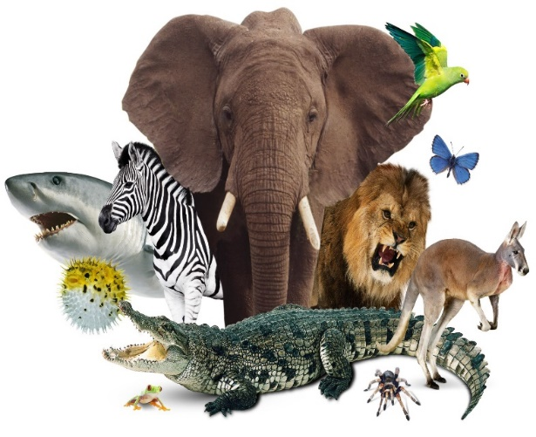
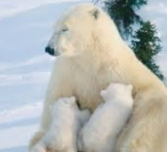
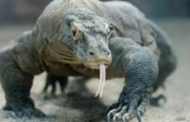
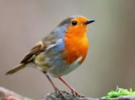
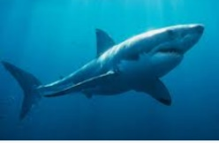
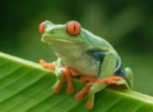
Animals including Humans – Year 1
- Animals are living things.
- Like plants, animals need food and water to live.
- Animals feed themselves by eating plants or other animals.
- Millions of animals live on earth.
Carnivore – eats meats
Herbivore – only eats plants
Omnivore – eats both meat and plants
Types of Animals
Mammals Mammals are warm-blooded creatures. Most have hair. They give birth to live young. They produce milk to feed them. Humans are mammals. Other examples are monkeys, lions, bears, dogs, cats and cows
Reptiles They lay eggs/ have scales. They breathe through their lungs. Lizards Crocodiles Snakes | Birds They lay eggs. They have wings to help them fly. They use beaks for eating. Their feathers keep them warm. Robins Penguins Ducks
Fish Fish live in water. They breathe through gills. They have fins/scales. Sharks Salmon Rays | Amphibians Amphibians live in water and land. Frogs Toads Salamanders

Slide 2
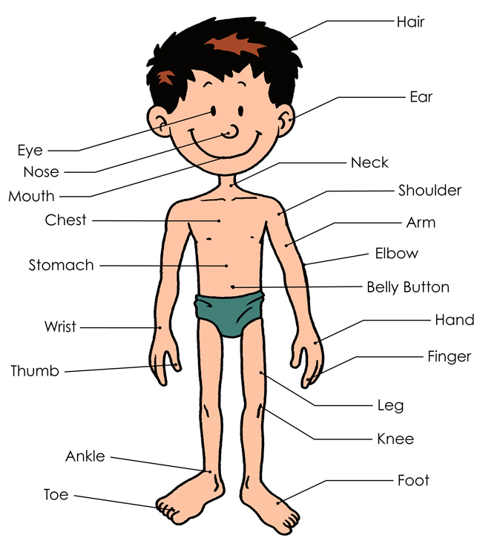
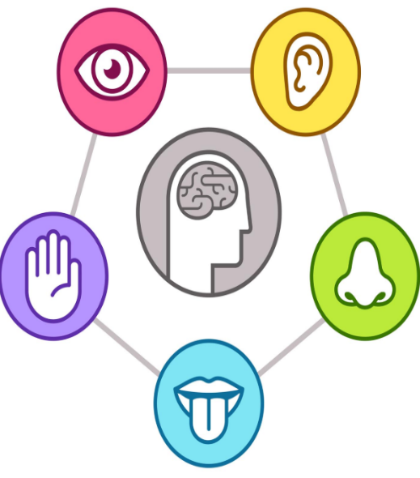
Animals including Humans – Year 1
Basic parts of the human body
Senses
Sight | Eyes help humans and most animals to see
Hearing | Ears help humans and most animals to hear
Smell | Noses help humans and most animals to smell
Taste | Tongues help humans and most animals to taste
Touch | Skin helps humans and most animals to feel

Slide 3
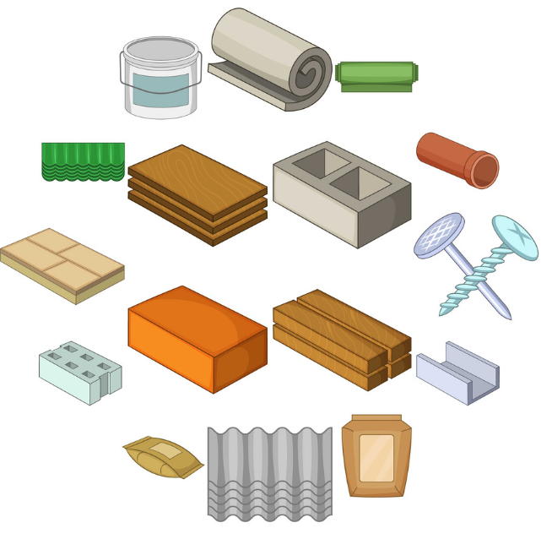
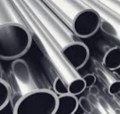
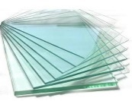
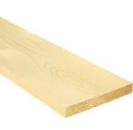
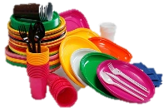
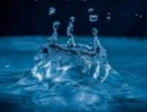

Materials – Year 1
Materials are the substances that things are made from.
We use lots of different materials every day
Some materials are used to make many things.
Soft materials
Wool, fabric, cotton
Hard materials
Metal, wood, plastic
Types of Materials
Metal -Metals are made from rocks. -Metal is strong and shiny. -Metals include aluminum, iron and steel. | Glass -Glass is made from fine sand. -Glass is very strong and clear (transparent). -Glass is used for windows and glasses.
Wood -Wood is made from trees. -Wood is a hard and strong material. - Woods include oak, pine and ash. | Plastic -Plastics can be made from lots of different materials. -Plastic can be tough or bendy, and so it is used for many different purposes.
Water -Water is a natural material -Water is clear and can take many shapes. It can be frozen into ice or heated into gas. | Paper -Paper is made from trees. -Paper is normally thin and can be made into different shapes. Lots of different things are made from paper.

Slide 4
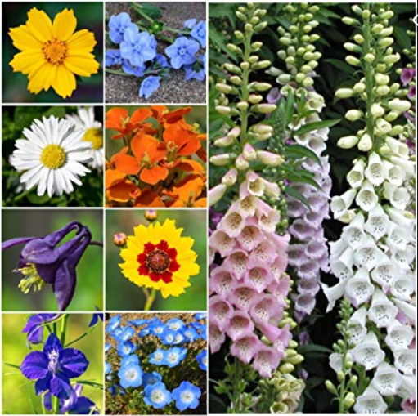
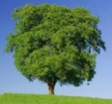
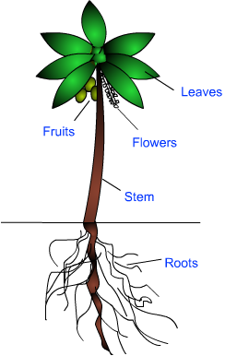
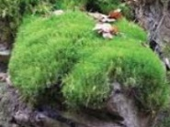
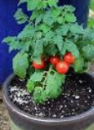
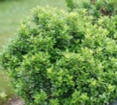
Plants – Year 1
Plants are a large group of living things that use sunlight to make their own food.
There are many different kinds of plants
Some plants are ‘flowering plants’ – they grow flowers sometimes.
Evergreen Trees
Keep their leaves all year round
Deciduous Trees
Lose their leaves in the winter
Basic parts of a plant
Types of Plants
Trees Trees are tall, woody plants. They usually have a stem called a trunk. Some trees can live for hundreds or even thousands of years. Trees include birches, palms and pines. | Moss Mosses are small, seedless plants that grow in moist places. Mosses grow together in large, thick mats.
Bushes/Shrubs Bushes and shrubs are quite low plants that have lots of branches. Bushes do not normally grow as tall as trees. | Vegetables Vegetables normally come from a type of plant called a herbaceous plant. Vegetables can be eaten.

Slide 5
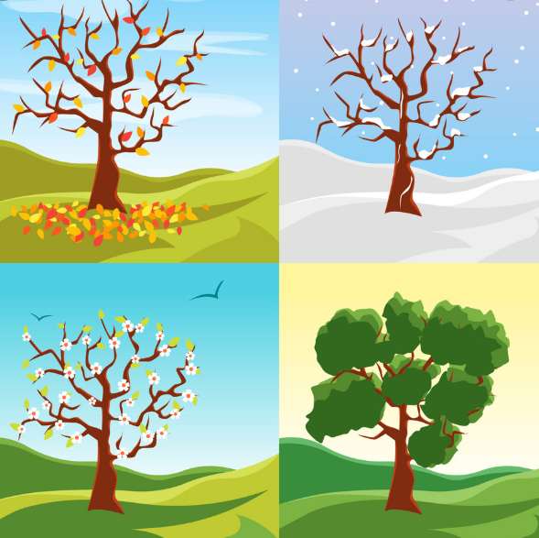


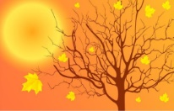

Seasonal Changes – Year 1
Seasons are different times in the year when there are weather changes.
In places like the UK, there are four seasons in a year: spring, summer, autumn and winter.
The seasons have an effect on landscapes, and plant and animal life.
The length of days changes as the seasons change.
The seasons are different in some other parts of the world
.
.
Seasons
Spring The weather starts to get warmer after winter. Baby animals are born and new flowers blossom. It takes place in March, April and May. | Summer Summer is the warmest season of the year. Insects such as wasps and bees are around, and plants have lots of leaves. The summer months are June, July & August.
Autumn The weather starts to get cooler after summer. Many types of leaves begin to turn brown and fall from trees. Autumn is September, October & November | Winter Winter is the coldest season of the year. Many trees have no leaves and many animals are hibernating. Winter is December, January & February.
Things to look out for:
Spring: Flowers growing, baby animals, frog spawn, birds building nests, caterpillars.
Summer: Flowers fully grown, insects, fully-grown frogs, trees with lots of leaves on.
Autumn: Brown leaves on the ground, squirrels storing nuts, hedgehogs hibernating.
Winter: Frost/snow, trees with no leaves, evergreen trees

