Slide 1
Year 4 Word List
Vocabulary Exploration

Slide 2
Please note;
Some of these words have multiple meanings and forms. Included in this presentation are the most commonly used word forms for Years 3 and 4.

Slide 3
Word | Meaning
calendar (noun) | A document that displays; days, weeks and months of a year.
In a Sentence | Drawing
I have bought a new calendar for the new year!

Slide 4
Word | Meaning
caught (verb) | Past participle of the verb ‘catch’.
In a Sentence | Drawing
I caught the baseball during the game.

Slide 5
Word | Meaning
centre | A point that is in the middle of an object.
In a Sentence | Drawing
I walked into the centre of the room.

Slide 6
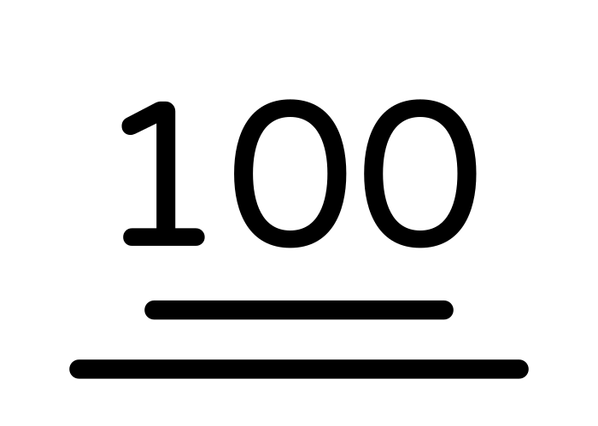
Word | Meaning
century (noun) | A period of 100 years. Roman army of approximately 100 men.
In a Sentence | Drawing
We are currently living in the 21st century.

Slide 7
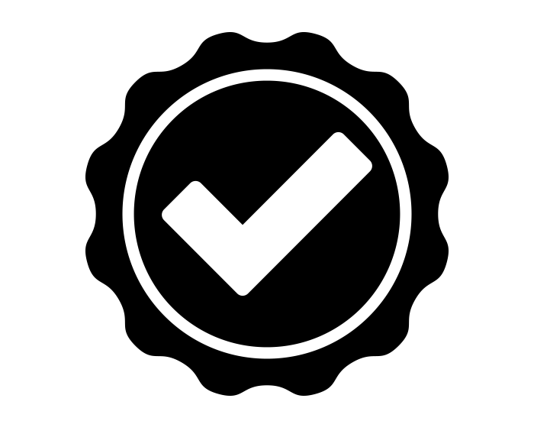
Word | Meaning
certain (adjective) | Free from doubt (to be confident)
In a Sentence | Drawing
I am certain that I have answered the question correctly.

Slide 8
Word | Meaning
circle (noun, verb) | Noun - a closed 2d shape with one side and no corners. Verb - to enclose in a circle
In a Sentence | Drawing
Noun - I can draw a perfect circle. Verb - I circle the correct answer on the page.

Slide 9
Word | Meaning
consider (verb) | To think carefully about a subject, in order to make a decision.
In a Sentence | Drawing
I have to consider all of the options, before I answer the question.

Slide 10
Word | Meaning
decide (verb) | To solve or conclude a question or query.
In a Sentence | Drawing
The judge will decide who wins the case.

Slide 11
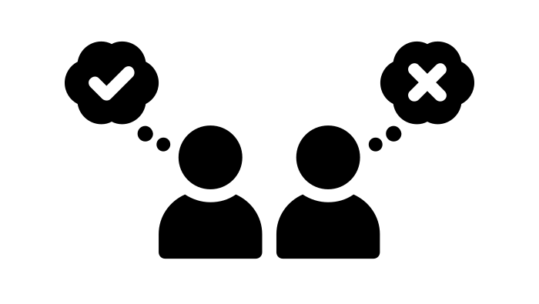
Word | Meaning
different (adjective) | Not alike in character or quality.
In a Sentence | Drawing
We have different answers for this question.

Slide 12
Word | Meaning
difficult (adjective) | Not easily done or achieved.
In a Sentence | Drawing
I find it difficult to understand this method.

Slide 13
Word | Meaning
exercise (noun, verb) | Noun - Something done or performed. Verb - To go through actions or exercises.
In a Sentence | Drawing
Noun - Walking is good exercise. Verb - I exercise almost everyday.

Slide 14
Word | Meaning
experience (noun, verb) | Noun - Personally encountering something. Verb - To have experience of.
In a Sentence | Drawing
Noun - I recently had an awful experience. Verb - I experience tiredness after exercise.

Slide 15
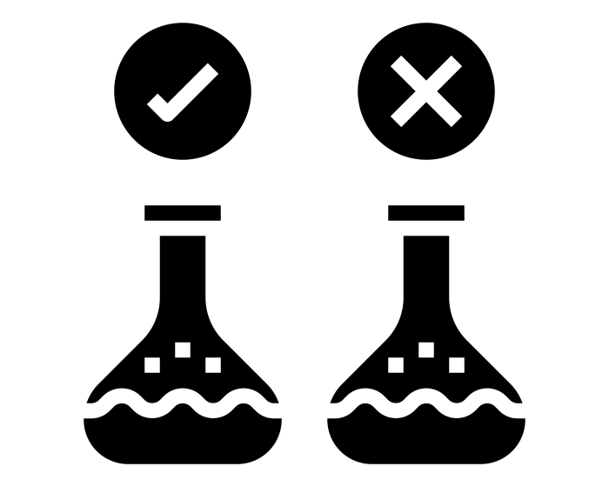
Word | Meaning
experiment (noun, verb) | Noun - a test or trial to discover something new OR to test a principle. Verb - action of experimenting
In a Sentence | Drawing
Noun - In science, we do experiments to test a theory. Verb - I experiment with different chemicals.

Slide 16
Word | Meaning
favourite (adjective, noun) | Adjective - Preferred above all others. Noun - Person or thing favoured above all others.
In a Sentence | Drawing
Adjective - Chocolate is my favourite flavour of ice cream. Noun - I am the favourite to win this game.

Slide 17
Word | Meaning
grammar (noun) | The study of the way language is constructed.
In a Sentence | Drawing
She said his grammar is very good.

Slide 18
Word | Meaning
increase (verb) | To make greater, as in number, size, strength, or quality.
In a Sentence | Drawing
I increase the size of my order.

Slide 19
Word | Meaning
important (adjective) | Of much or great significance or consequence:
In a Sentence | Drawing
This is a very important event.

Slide 20
Word | Meaning
interest (noun) | Curiosity is engaged by something (subject/s).
In a Sentence | Drawing
I have an interest in the history of the Vikings.

Slide 21
Word | Meaning
knowledge (noun) | Acquiring and gathering facts and truths from study.
In a Sentence | Drawing
I have knowledge of many things related to the Vikings.

Slide 22
Word | Meaning
length (noun) | Measurement from end to end.
In a Sentence | Drawing
The length of the River Nile is 4,132 miles.

Slide 23
Word | Meaning
material (noun) | Substance or substances of which a thing is made of.
In a Sentence | Drawing
Wood is an effective material to use for building a wardrobe.

Slide 24
Word | Meaning
medicine (noun) | Substance or substances used to treat an illness or disease.
In a Sentence | Drawing
I take medicine for my cough.

Slide 25
Word | Meaning
mention (verb) | To refer briefly to a; name, place or topic.
In a Sentence | Drawing
You didn’t mention this information to me earlier.

Slide 26
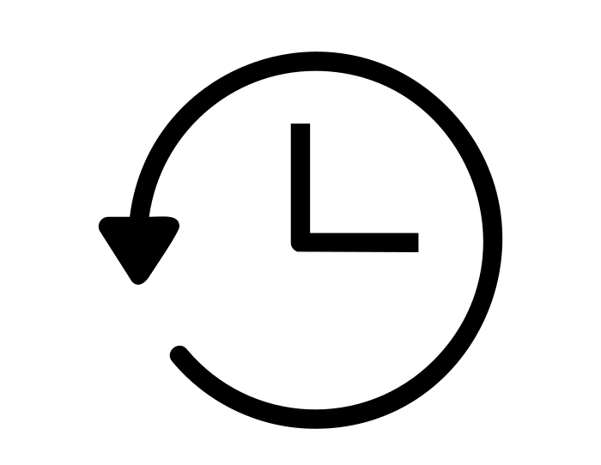
Word | Meaning
minute (noun) | A short space of time (6o seconds)
In a Sentence | Drawing
I have one minute left on the timer.

Slide 27
Word | Meaning
naughty (adjective) | Disobedient or mischievous behaviour.
In a Sentence | Drawing
My dog was being very naughty this morning.

Slide 28
Word | Meaning
notice (noun, verb) | Noun - information or warning of something. Verb - To pay attention or be aware of something.
In a Sentence | Drawing
Noun - I gave a day’s notice of my departure. Verb - I notice something peculiar in the bushes.

Slide 29
Word | Meaning
opposite (adjective, preposition) | Adjective - Corresponding positions. Preposition - Across from or facing.
In a Sentence | Drawing
Adjective - We stand at opposite ends of the room. Preposition - I sat opposite from the teacher in the room.

Slide 30
Word | Meaning
particular (adjective) | Relating to a specific; person, group or thing.
In a Sentence | Drawing
Look at this particular word in the text.

Slide 31
Word | Meaning
peculiar (adjective) | Strange or odd compared to other things.
In a Sentence | Drawing
There is a peculiar sound coming from the basement.

Slide 32
Word | Meaning
perhaps (adverb) | Maybe or possible.
In a Sentence | Drawing
Perhaps it will be sunny tomorrow.

Slide 33
Word | Meaning
popular (adjective) | Regarded with favour or approval of others.
In a Sentence | Drawing
Chocolate is the most popular flavour of ice cream.

Slide 34
Word | Meaning
position (noun, verb) | Noun - Reference to a place; location or situation. Verb - to put in a particular place.
In a Sentence | Drawing
Noun - I am in a difficult position. Verb - I position my seat close to the board.

Slide 35
Word | Meaning
possession (noun) | Ownership of something or someone.
In a Sentence | Drawing
These are my most valuable possessions.

Slide 36
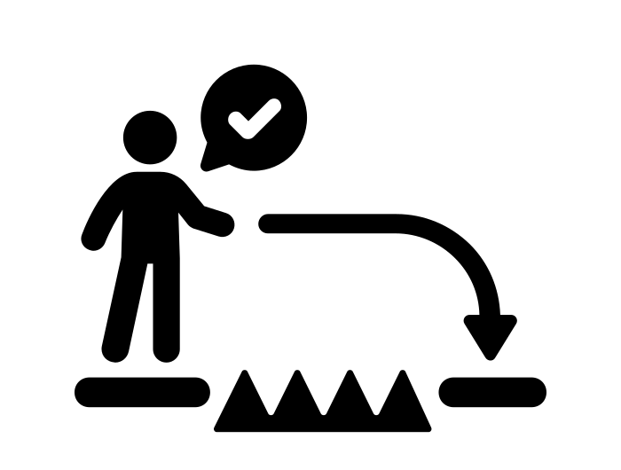
Word | Meaning
possible (adjective) | Something that may or can be done/used.
In a Sentence | Drawing
It is possible to overcome this challenge.

Slide 37
Word | Meaning
potatoes (noun) | Root vegetable part of the nightshade plant family.
In a Sentence | Drawing
I eat vegetables with my potatoes.

Slide 38
Word | Meaning
promise (noun, verb) | Noun - something that will or will not be done. Verb - to make a promise.
In a Sentence | Drawing
Noun - I make a promise to do better at school. Verb - I promise I will help you tomorrow.

Slide 39
Word | Meaning
purpose (noun) | The reason for which something is done or exists.
In a Sentence | Drawing
The purpose of research is to discover new information.

Slide 40
Word | Meaning
question (noun, verb) | Noun - sentence addressing someone to gather more information. Verb - to ask or interrogate.
In a Sentence | Drawing
Noun - I ask a question to my teacher, as I do not understand. Verb - I question my teacher as I do not understand.

Slide 41
Word | Meaning
recent (adjective) | Lately happening/occurrence.
In a Sentence | Drawing
My recent trip to Dubai was fantastic!

Slide 42
Word | Meaning
regular (adjective) | Usual or normal.
In a Sentence | Drawing
I eat my regular lunch everyday.

Slide 43
Word | Meaning
sentence (noun) | A grammatical term for a word/group of words that forms an independent clause.
In a Sentence | Drawing
I place a capital letter at the beginning of a sentence.

Slide 44
Word | Meaning
separate (verb, adjective) | Verb - to keep apart or divide. Adjective - detached or disconnected.
In a Sentence | Drawing
Verb - I separate the curtains, as it is morning. Adjective - I ask two separate questions.

Slide 45
Word | Meaning
special (adjective) | Distinct or particular kind.
In a Sentence | Drawing
This is a very special artefact from the Viking era.

Slide 46
Word | Meaning
strength (noun) | Quality of being strong.
In a Sentence | Drawing
She had great strength to lift the weights.

Slide 47
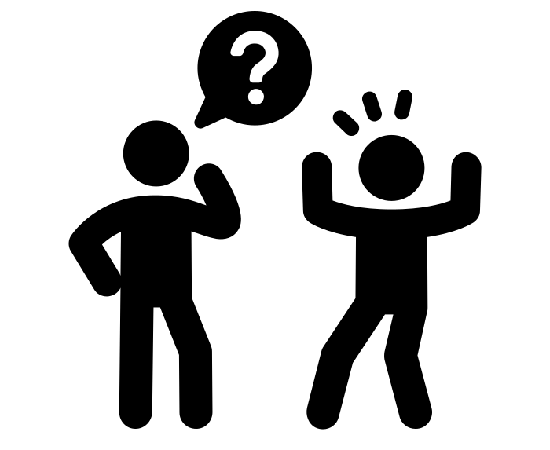
Word | Meaning
suppose (verb) | To assume or consider a possibility.
In a Sentence | Drawing
I suppose you could have the right answer.

Slide 48
Word | Meaning
surprise (verb, noun) | Verb - sudden feeling of wonder or astonishment. Noun - act of surprising or being surprised.
In a Sentence | Drawing
Verb - My mother surprised me with a party. Noun - His answer was a surprise to everyone.

Slide 49
Word | Meaning
therefore (adverb) | As a result
In a Sentence | Drawing
I am sleepy, therefore I am going to bed.

Slide 50
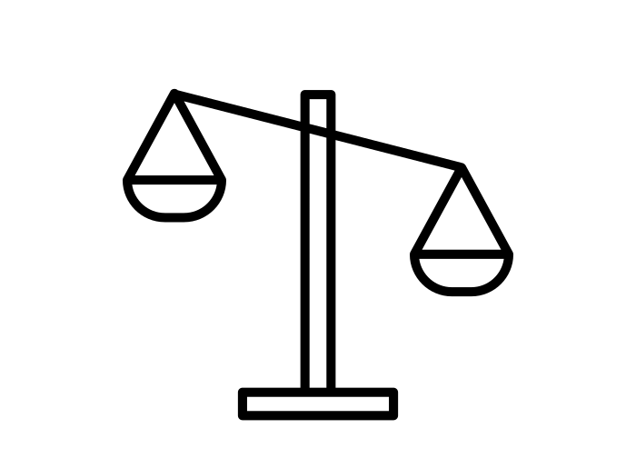
Word | Meaning
though (conjunction) | Mainly used as a subordinating conjunction.
In a Sentence | Drawing
Though he tried very hard, he failed the course.

Slide 51
Word | Meaning
although (conjunction) | In spite of the fact.
In a Sentence | Drawing
Although Amy tried hard, she didn’t pass her exam.

Slide 52
Word | Meaning
thought (noun, verb) | Noun - Product of mental activity (idea or notion). Verb - past participle of ‘think’
In a Sentence | Drawing
Noun - I was deep in thought. Verb - I thought of a fantastic idea today!

Slide 53
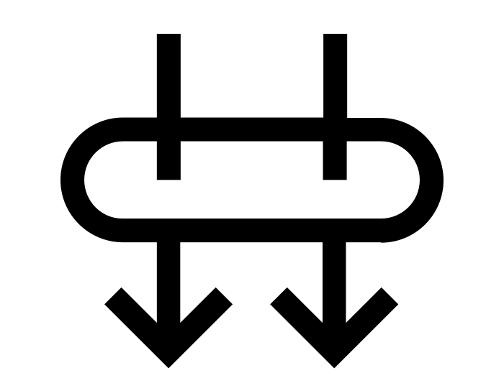
Word | Meaning
through (preposition/adverb) | Preposition and Adverb - in at one end, and out at the other.
In a Sentence | Drawing
Preposition/Adverb - The sun came through my window.

