Slide 1
Year 6 Word List
Vocabulary Exploration

Slide 2
Please note;
Some of these words have multiple meanings and forms. Included in this presentation are the most commonly used word forms for Years 5/6.

Slide 3
Word | Meaning
accommodate (verb) | To do a kindness or a favor to oblige.
In a Sentence | Drawing
I accommodate a friend by helping them move into a new house.

Slide 4
Word | Meaning
accompany (verb) | To go along or in company with/join in action.
In a Sentence | Drawing
Can I accompany you to the cinema?

Slide 5
Word | Meaning
according to (preposition) | In agreement or accord with another.
In a Sentence | Drawing
According to the police, they have not found the criminal.

Slide 6
Word | Meaning
achieve (verb) | To bring to a successful end or to achieve.
In a Sentence | Drawing
You could achieve a good score for this test, if you revise.

Slide 7
Word | Meaning
aggressive (adjective) | Vigorously energetic, especially in the use of initiative and forcefulness.
In a Sentence | Drawing
You are being aggressive towards me right now!

Slide 8
Word | Meaning
amateur (noun, adjective) | Noun - A person who engages in a study, sport, or other activity for pleasure rather than for financial benefit. Adjective - a person who engages in a study, sport, or other activity for pleasure rather than for financial benefit
In a Sentence | Drawing
Noun - I am only an amateur performer. Adjective - These are amateur performers - not professional.

Slide 9
Word | Meaning
apparent (adjective) | Something that is readily seen and exposed to sight.
In a Sentence | Drawing
The crack in the wall is easily apparent.

Slide 10
Word | Meaning
appreciate (verb) | To be grateful or thankful for something.
In a Sentence | Drawing
I appreciate how kind you have been to me.

Slide 11
Word | Meaning
attached (adjective) | Joined, connected or bound to something.
In a Sentence | Drawing
The handle is attached to the door.

Slide 12
Word | Meaning
committee (noun) | A person or group of persons elected or appointed to perform a service.
In a Sentence | Drawing
We should discuss this proposal with the committee.

Slide 13
Word | Meaning
communicate (verb) | To give or interchange thoughts, feelings, information, or the like, by writing, speaking, etc.
In a Sentence | Drawing
I am communicating my ideas, but you are not listening.

Slide 14
Word | Meaning
community (noun) | A social group of any size whose members reside in a specific locality, share government, and often have a common cultural and historical heritage.
In a Sentence | Drawing
I belong to a diverse community.

Slide 15
Word | Meaning
conscience (noun) | The inner sense of what is right or wrong in one's conduct or motives, impelling one toward right action.
In a Sentence | Drawing
He told the truth for his conscience's sake.

Slide 16
Word | Meaning
conscious (adjective) | Aware of one's own existence, sensations, thoughts, surroundings, etc.
In a Sentence | Drawing
I wasn't even conscious of what was happening.

Slide 17
Word | Meaning
convenience (noun) | Anything that saves or simplifies work, adds to one's ease or comfort, etc., as an appliance, utensil, or the like.
In a Sentence | Drawing
I will honor my end of the bargain at my convenience, not yours!

Slide 18
Word | Meaning
correspond (verb) | To be similar or equivalent in function, position, amount, etc.
In a Sentence | Drawing
His actions do not correspond with his words.

Slide 19
Word | Meaning
criticise (ing) (verb) | To make judgments as to merits and faults.
In a Sentence | Drawing
I am criticising your decision as it is not the right choice.

Slide 20
Word | Meaning
definite (adjective) | Firm, clear and unlikely to change.
In a Sentence | Drawing
I know for a definite that it will rain today.

Slide 21
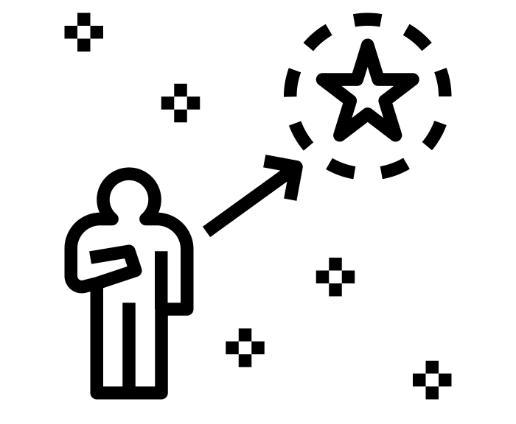
Word | Meaning
determined (adjective) | The firm decision to do something.
In a Sentence | Drawing
I am determined to get better at swimming.

Slide 22
Word | Meaning
disastrous (adjective) | Extremely bad circumstances or events.
In a Sentence | Drawing
The recent earthquake was disastrous.

Slide 23
Word | Meaning
environment (noun) | All the circumstances, people, things, and events around them that influence their life.
In a Sentence | Drawing
Due to global warming, we need to pay more attention to the environment.

Slide 24
Word | Meaning
equipped (adjective) | Provided with equipment.
In a Sentence | Drawing
I am equipped to climb the mountain this week.

Slide 25
Word | Meaning
equipment (noun) | Things which are used for a particular purpose, for example a hobby or job.
In a Sentence | Drawing
Have you got your equipment ready for school?

Slide 26
Word | Meaning
especially (adverb) | Emphasise that what you are saying applies more to one person, thing, or area than to any others. It can also emphasise a characteristic.
In a Sentence | Drawing
The weather is especially hot today!

Slide 27
Word | Meaning
forty (40) (number) | Forty represents the number 40.
In a Sentence | Drawing
I have travelled forty miles today.

Slide 28
Word | Meaning
frequently (adverb) | At frequent or brief intervals; often
In a Sentence | Drawing
I frequently go running to improve my health.

Slide 29
Word | Meaning
immediate (adjective) | An immediate result, action, or reaction happens or is done without any delay.
In a Sentence | Drawing
My immediate reaction was just disgust.

Slide 30
Word | Meaning
immediately (adverb) | If something happens immediately, it happens without any delay.
In a Sentence | Drawing
I immediately answered the phone.

Slide 31
Word | Meaning
language (noun) | A language is a system of communication which consists of a set of sounds and written symbols which are used by the people of a particular country or region for talking or writing.
In a Sentence | Drawing
I am learning a new language at school.

Slide 32
Word | Meaning
lightning (noun, adjective) | Noun - Lightning is the very bright flashes of light in the sky that happen during thunderstorms. Adjective - something that happens very quickly.
In a Sentence | Drawing
Noun - Did you see the lightning last night? Adjective - the fox moved at lightning speed.

Slide 33
Word | Meaning
marvellous (adjective) | If you describe someone or something as marvellous, you are emphasizing that they are very good.
In a Sentence | Drawing
She looked marvellous in her dress.

Slide 34
Word | Meaning
mischievous (adjective) | A mischievous person/animal likes to have fun by playing harmless tricks on people or doing things they are not supposed to do.
In a Sentence | Drawing
My dog was being very mischievous at the park.

Slide 35
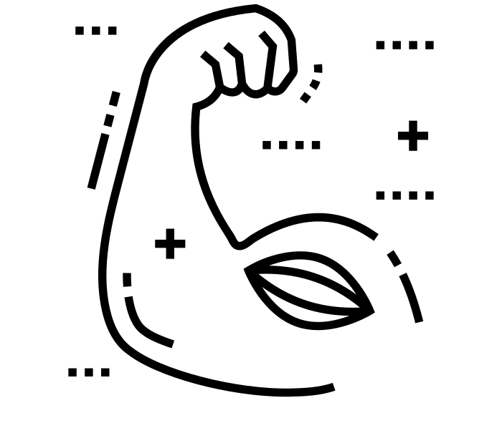
Word | Meaning
muscle (noun) | A muscle is a piece of tissue inside your body which connects two bones and which you use when you make a movement.
In a Sentence | Drawing
Keeping your muscle(s) strong helps you to avoid back problems.

Slide 36
Word | Meaning
necessary (adjective) | Something that is necessary is needed in order for something else to happen.
In a Sentence | Drawing
It is necessary to use all of these ingredients to make the cake.

Slide 37
Word | Meaning
neighbour (noun) | Your neighbour is someone who lives near you/next to you.
In a Sentence | Drawing
I really get on with my neighbour and her family.

Slide 38
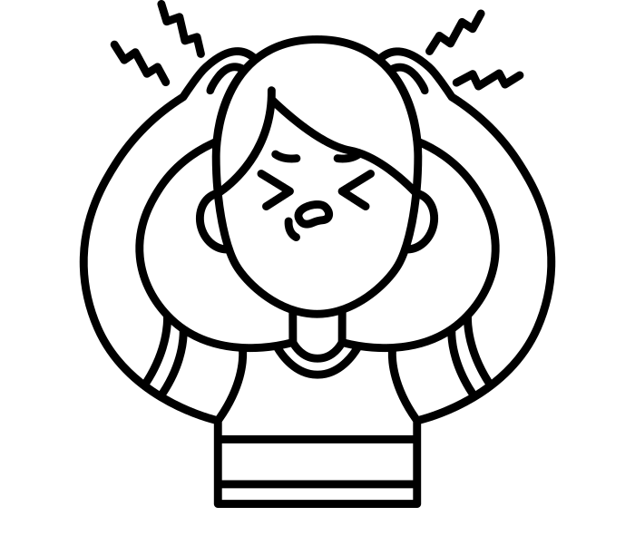
Word | Meaning
nuisance (noun) | If you say that someone or something is a nuisance, you mean that they annoy you or cause you a lot of problems.
In a Sentence | Drawing
You have been a nuisance today, and I am very disappointed.

Slide 39
Word | Meaning
occupy (verb) | The people who occupy a building or a place are the people who live or work there.
In a Sentence | Drawing
Over forty people occupy these apartments.

Slide 40
Word | Meaning
occur (verb) | When something occurs, it happens.
In a Sentence | Drawing
My headaches only occur at night.

Slide 41
Word | Meaning
opportunity (noun) | An opportunity is a situation in which it is possible for you to do something that you want to do.
In a Sentence | Drawing
There is an opportunity for you to attend the best university.

Slide 42
Word | Meaning
parliament (proper noun) | The parliament of some countries, for example Britain, is the group of people who make or change its laws, and decide what policies the country should follow.
In a Sentence | Drawing
Parliament today approved the policy, but it has not yet become law.

Slide 43
Word | Meaning
physical (adjective) | Physical qualities, actions, or things are connected with a person's body, rather than with their mind.
In a Sentence | Drawing
Physical activity promotes good health.

Slide 44
Word | Meaning
prejudice (noun) | Prejudice is an unreasonable dislike of a particular group of people or things, or a preference for one group of people or things over another.
In a Sentence | Drawing
There is widespread prejudice in this country, and we need to overcome it.

Slide 45
Word | Meaning
profession (noun) | A profession is a type of job that requires advanced education or training.
In a Sentence | Drawing
Mr Alfred was a teacher by profession.

Slide 46
Word | Meaning
programme (noun, verb) | Noun - A programme of actions or events is a series of actions or events that are planned to be done. Verb - When you programme a machine or system, you set its controls so that it will work in a particular way.
In a Sentence | Drawing
Noun - This activity programme looks very exciting! Verb - I need to (re)programme the computer as it does not work.

Slide 47
Word | Meaning
pronunciation (noun) | The pronunciation of a word or language is the way in which it is pronounced.
In a Sentence | Drawing
She gave the word its Spanish pronunciation.

Slide 48
Word | Meaning
recommend (verb) | If someone recommends a person or thing to you, they suggest that you would find that person or thing good or useful.
In a Sentence | Drawing
I would highly recommend this new restaurant.

Slide 49
Word | Meaning
restaurant (noun) | A restaurant is a place where you can eat a meal and pay for it. In restaurants your food is usually served to you at your table by a waiter or waitress.
In a Sentence | Drawing
I adore the food at this restaurant.

Slide 50
Word | Meaning
rhythm (noun) | A rhythm is a regular series of sounds or movements.
In a Sentence | Drawing
The rhythm of this song is upbeat and exciting!

Slide 51
Word | Meaning
sincere (adjective) | If you say that someone is sincere, you approve of them because they really mean the things they say. You can also describe someone's behaviour and beliefs as sincere.
In a Sentence | Drawing
There was a sincere expression of hope on both their faces.

Slide 52
Word | Meaning
sincerely (adverb, convention) | Adjective - If you say or feel something sincerely, you really mean or feel it, and are not pretending. Convention - In Britain, people write 'Yours sincerely' before their signature at the end of a formal letter or email when they have addressed it to someone by name.
In a Sentence | Drawing
Adjective - I sincerely hope you mean the apology. Convention - ‘Yours Sincerely - Mr Bache’

Slide 53
Word | Meaning
soldier (noun) | A soldier is a person who works in an army, especially a person who is not an officer.
In a Sentence | Drawing
I served as a soldier in the war.

Slide 54
Word | Meaning
stomach (noun) | Your stomach is the organ inside your body where food is digested before it moves into the intestines.
In a Sentence | Drawing
My stomach is completely full.

Slide 55
Word | Meaning
sufficient (adjective) | If something is sufficient for a particular purpose, there is enough of it for the purpose.
In a Sentence | Drawing
There was not sufficient evidence to secure a conviction.

Slide 56
Word | Meaning
suggest (verb) | If you suggest something, you put forward a plan or idea for someone to think about.
In a Sentence | Drawing
I suggest you ask him some specific questions about the lesson.

Slide 57
Word | Meaning
temperature (noun) | The temperature of something is a measure of how hot or cold it is.
In a Sentence | Drawing
The temperature of the water was about 40 degrees.

Slide 58
Word | Meaning
thorough (adjective) | A thorough action or activity is one that is done very carefully and in a detailed way so that nothing is forgotten.
In a Sentence | Drawing
We are making a thorough investigation.

Slide 59
Word | Meaning
yacht (noun) | A yacht is a large boat with sails or a motor, used for racing or pleasure trips.
In a Sentence | Drawing
The yacht was up against a huge storm.

