Slide 1
Year 3 Word List
Vocabulary Exploration

Slide 2
Please note;
Some of these words have multiple meanings and forms. Included in this presentation are the most commonly used word forms for Years 3 and 4.

Slide 3
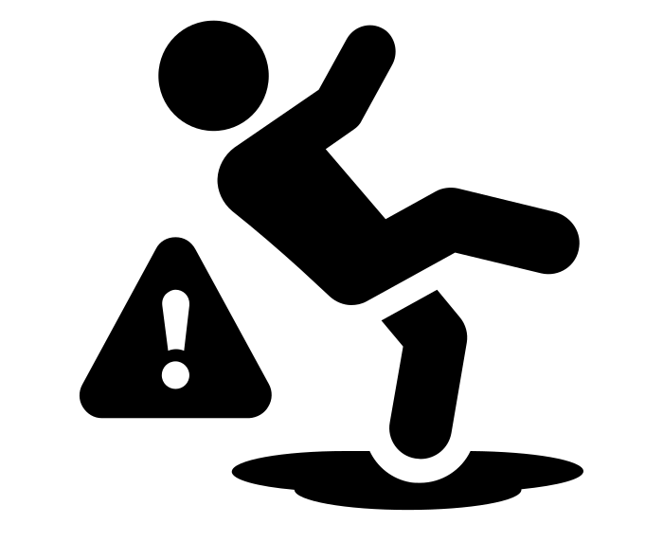
Word | Meaning
accident (noun) | An event that happens unexpectedly, without purpose.
In a Sentence | Drawing
I had an accident on my bike last week.

Slide 4
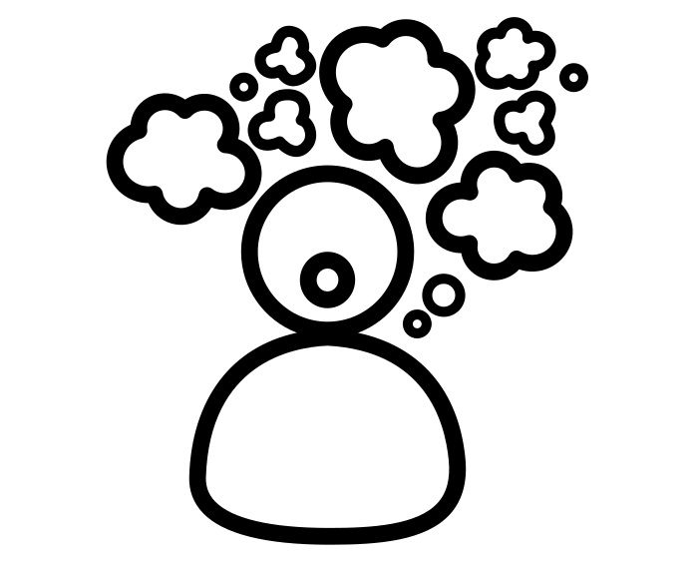
Word | Meaning
accidentally (adverb) | Happening by chance (from the root word ‘accident’).
In a Sentence | Drawing
I accidentally forgot my lunch!

Slide 5
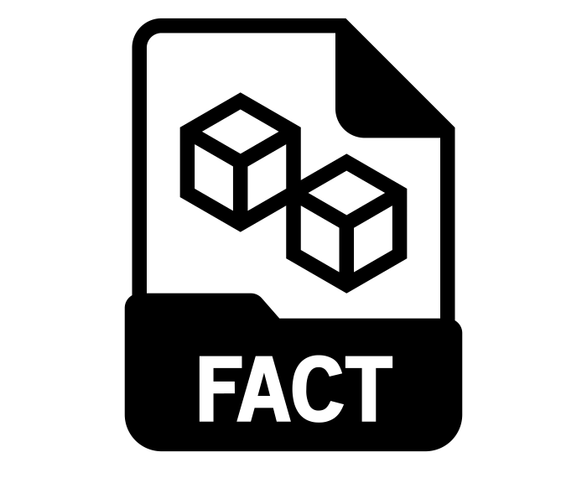
Word | Meaning
actual (adjective) | Existing or factually present
In a Sentence | Drawing
I can’t give you the actual answer, because I haven’t worked it out.

Slide 6
Word | Meaning
actually (adverb) | As a fact or something currently present.
In a Sentence | Drawing
I have actually worked out the answer, using my method.

Slide 7
Word | Meaning
address (noun) | Intended location linked to a piece of mail. Where someone resides (lives).
In a Sentence | Drawing
I deliver a letter to an address.

Slide 8
Word | Meaning
address (verb) | To direct speech or a written statement at someone (formal language).
In a Sentence | Drawing
The Principal would like to address the students.

Slide 9
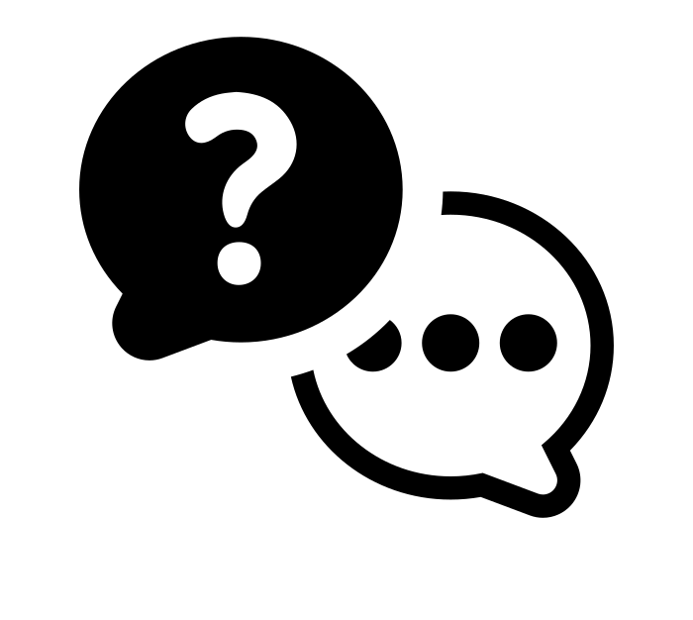
Word | Meaning
answer (verb,noun) | Verb - To respond to someone written or verbally. Noun - a verbal or written response
In a Sentence | Drawing
Verb - Can answer my question? Noun - I have received his answer.

Slide 10
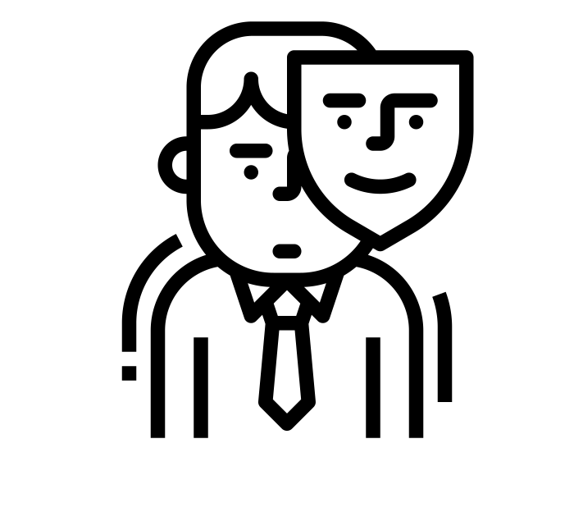
Word | Meaning
appear (verb) | To come into sight or to have the appearance of being.
In a Sentence | Drawing
I appear to be confident, but I am actually shy.

Slide 11
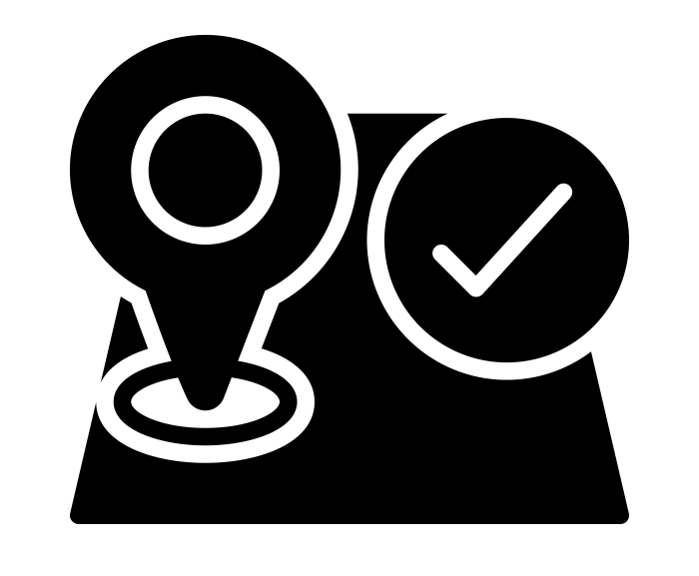
Word | Meaning
arrive (verb) | To reach a destination.
In a Sentence | Drawing
I finally arrive at school, after missing my bus.

Slide 12
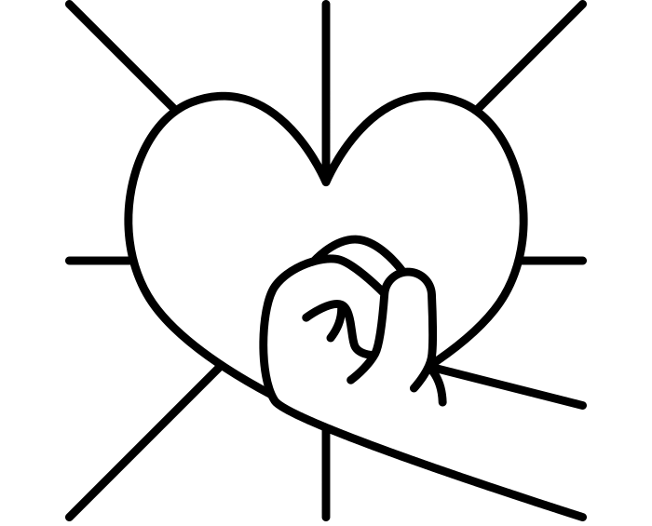
Word | Meaning
believe (verb) | To be confident with the truth/fact.
In a Sentence | Drawing
I have to believe her, because I know it is true.

Slide 13
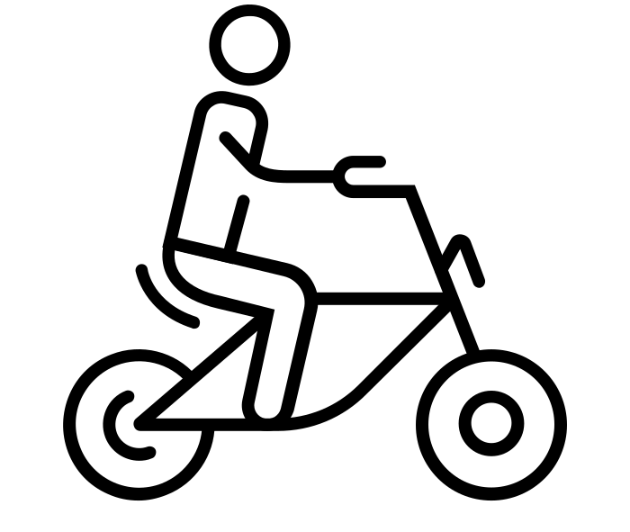
Word | Meaning
bicycle (noun) | A vehicle with two wheels, usually with pedals.
In a Sentence | Drawing
I rode my bicycle last week.

Slide 14
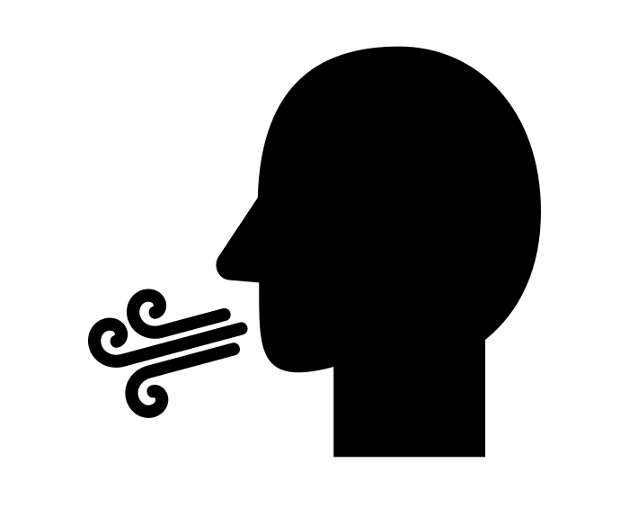
Word | Meaning
breath (noun) | Air is inhaled and exhaled (respiration).
In a Sentence | Drawing
I took a deep breath.

Slide 15
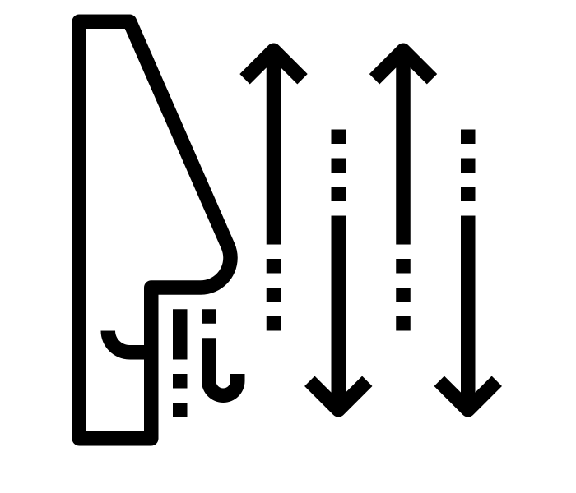
Word | Meaning
breathe (verb) | To inhale and exhale air.
In a Sentence | Drawing
I struggle to breathe, because I am exhausted.

Slide 16
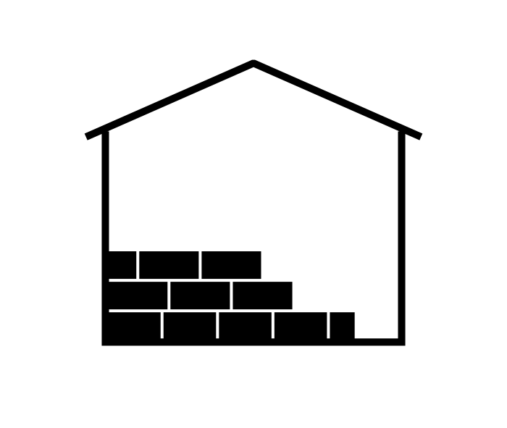
Word | Meaning
build (verb) | To construct by joining parts together.
In a Sentence | Drawing
One day, I would like to build my own house.

Slide 17
Word | Meaning
busy (adjective) | Full of OR engaged with a task.
In a Sentence | Drawing
It was very busy on the train this morning.

Slide 18
Word | Meaning
business (noun) | Occupation or trade
In a Sentence | Drawing
There is a new business in the centre of town.

Slide 19
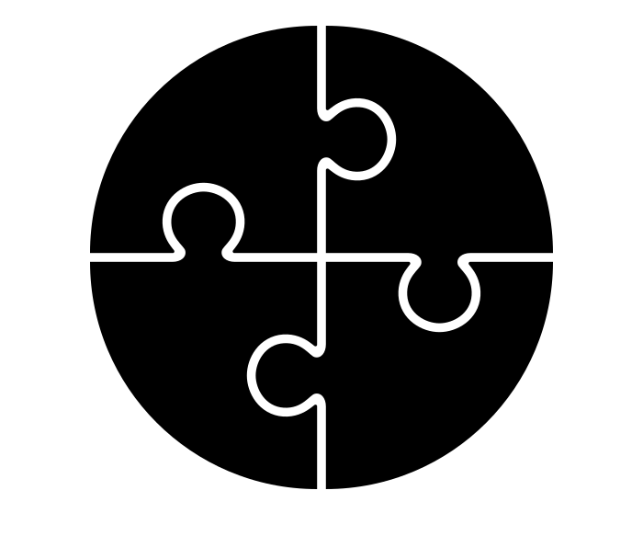
Word | Meaning
complete (adjective, verb) | Adjective - Finished, ended or concluded. Verb - to finish or end.
In a Sentence | Drawing
Adjective - My home learning is complete. Verb - I have to complete my home learning.

Slide 20
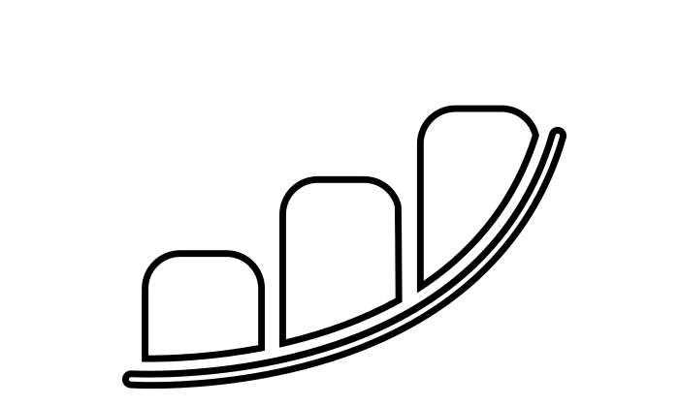
Word | Meaning
continue (verb) | To go or keep on with the same action.
In a Sentence | Drawing
I continue my journey until it is complete.

Slide 21
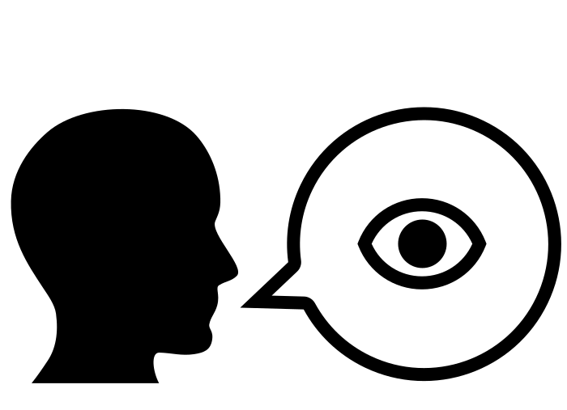
Word | Meaning
describe (verb) | To tell in written or spoken words.
In a Sentence | Drawing
Can you describe this picture?

Slide 22
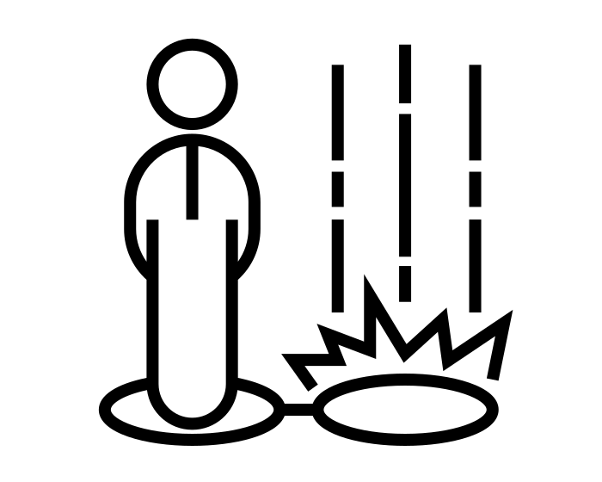
Word | Meaning
disappear (verb) | To vanish from sight.
In a Sentence | Drawing
They disappear to find shelter from the rain.

Slide 23
Word | Meaning
early (adverb, adjective) | Adverb - in the first past of a period of time. Adjective - occurring in the first part of a period of time.
In a Sentence | Drawing
Adverb - I get up early for school. Adjective - I will have an early dinner.

Slide 24
Word | Meaning
earth (noun) | The planet third in order from the sun. Can also refer to solid matter (ground).
In a Sentence | Drawing
We live on planet Earth.

Slide 25
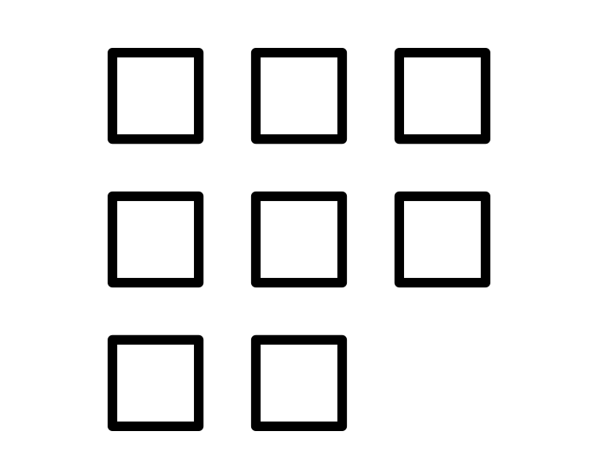
Word | Meaning
eight (noun, adjective) | Noun - The number coming after seven. Adjective - Amount, in relation to the noun.
In a Sentence | Drawing
Noun - Seven add one equals eight. Adjective - I have eaten eight sweets.

Slide 26
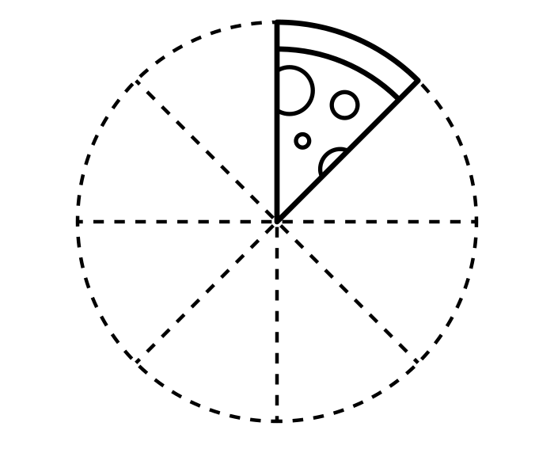
Word | Meaning
eighth (adjective, noun) | Adjective - after the seventh Noun - one of eight equal parts (fraction)
In a Sentence | Drawing
Adjective - This is my eighth attempt. Noun - eight eighths is equal to one whole.

Slide 27
Word | Meaning
enough (adjective) | Adequate quantity for want or need. (there are many different uses of this word e.g. determiner and adverb).
In a Sentence | Drawing
I have had enough food for one day.

Slide 28
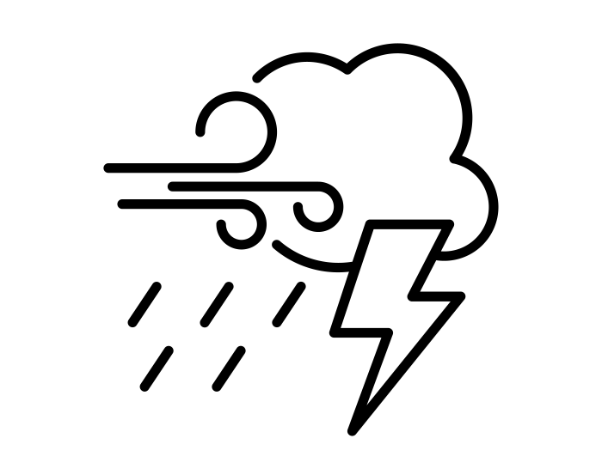
Word | Meaning
extreme (adjective) | Farthest removed from normality.
In a Sentence | Drawing
We have experienced extreme weather this year.

Slide 29
Word | Meaning
famous (adjective) | To have a widespread reputation.
In a Sentence | Drawing
I used to be a famous actor!

Slide 30
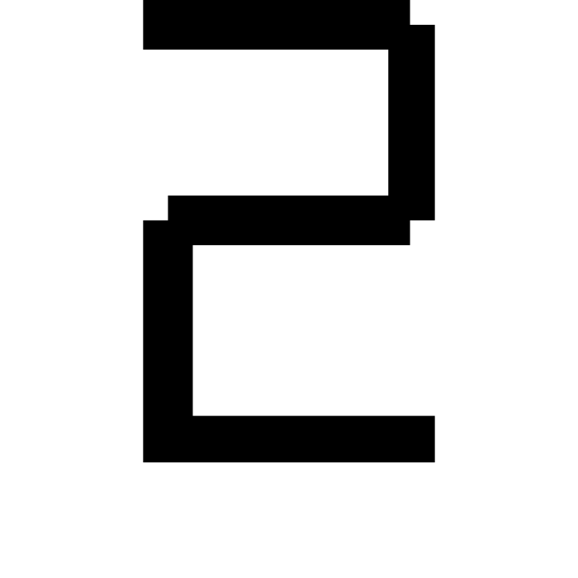
Word | Meaning
February (noun) | The second month of the calendar year.
In a Sentence | Drawing
There are typically 28 days in the month of February.

Slide 31
Word | Meaning
forward (adverb) | Towards a place, time or point.
In a Sentence | Drawing
Let’s move forward so we can hear better.

Slide 32
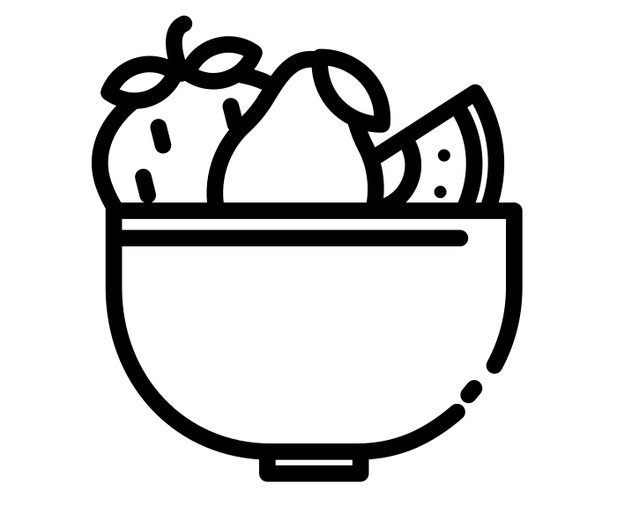
Word | Meaning
fruit (noun) | Any product of plant growth useful to humans or animals.
In a Sentence | Drawing
This is a lovely bowl of fruit.

Slide 33
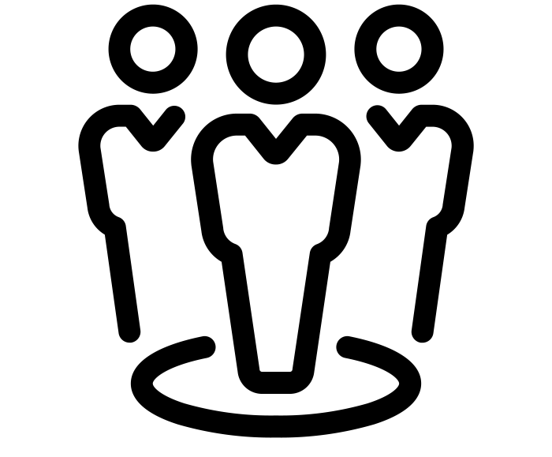
Word | Meaning
group (noun) | A collection of objects, related in a specific way.
In a Sentence | Drawing
A group of children played a game of football.

Slide 34
Word | Meaning
guard (verb, noun) | Verb - To keep safe from harm or danger. Noun - a person/persons that guards and protects.
In a Sentence | Drawing
Verb - I guard the castle to protect the King. Noun - The guards are on watch.

Slide 35
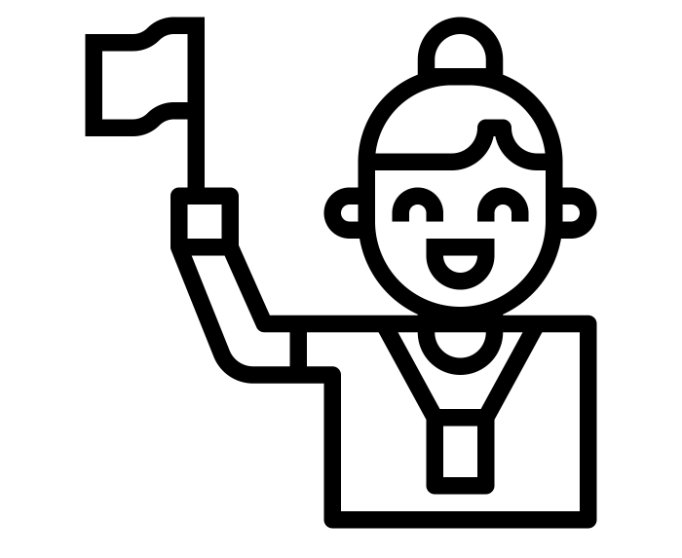
Word | Meaning
guide (verb, noun) | Verb - to assist someone to reach a destination. Noun - A person who guides. A book giving information or advice.
In a Sentence | Drawing
Verb - I guide the group around the museum. Noun - I read the guide carefully.

Slide 36
Word | Meaning
heard (verb) | Past tense of the verb ‘to hear’.
In a Sentence | Drawing
I heard a noise coming from the kitchen.

Slide 37
Word | Meaning
heart (noun) | An organ of the body for blood circulation.
In a Sentence | Drawing
In humans, the heart is roughly the size of a large fist.

Slide 38
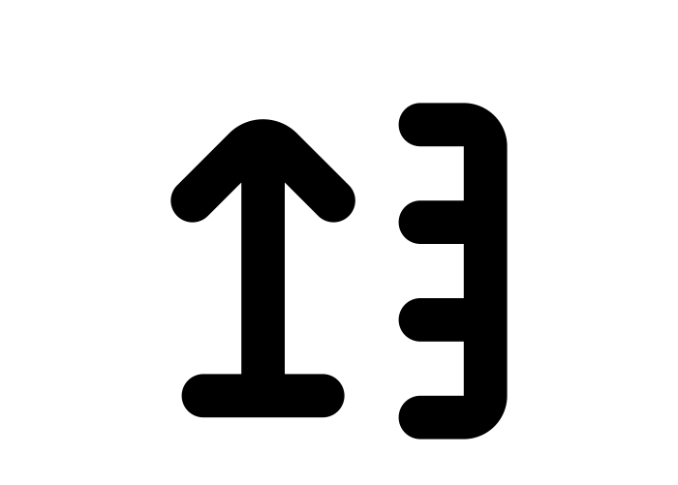
Word | Meaning
height (noun) | Distance upward from a given level.
In a Sentence | Drawing
The height of this table is 60cm.

Slide 39
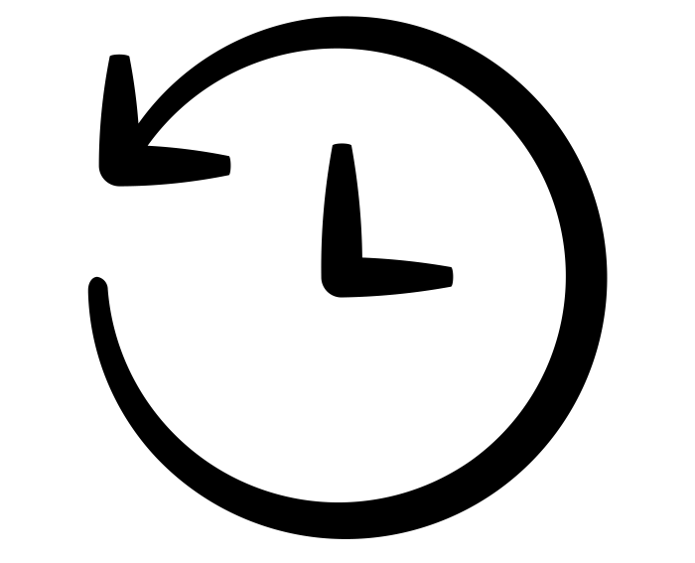
Word | Meaning
history (noun) | The study of past events, connect systematically and chronologically.
In a Sentence | Drawing
The history of the Romans is fascinating!

Slide 40
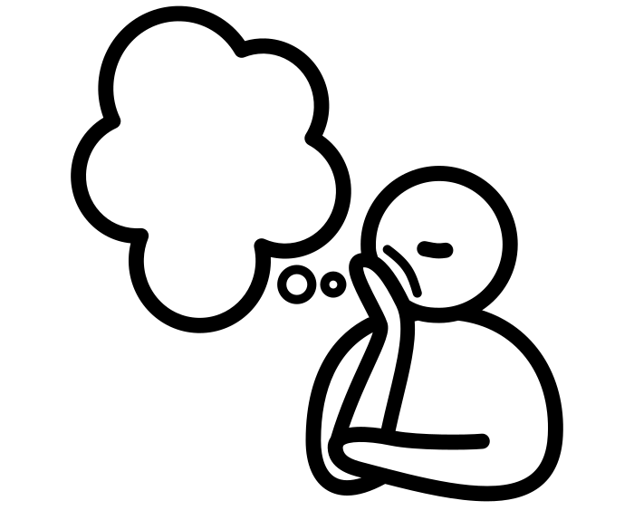
Word | Meaning
imagine (verb) | To form a mental image of (something not actually present to the senses).
In a Sentence | Drawing
I imagine that the house is haunted.

Slide 41
Word | Meaning
island (noun) | Small piece of land surrounded by water.
In a Sentence | Drawing
There is treasure buried on that island!

Slide 42
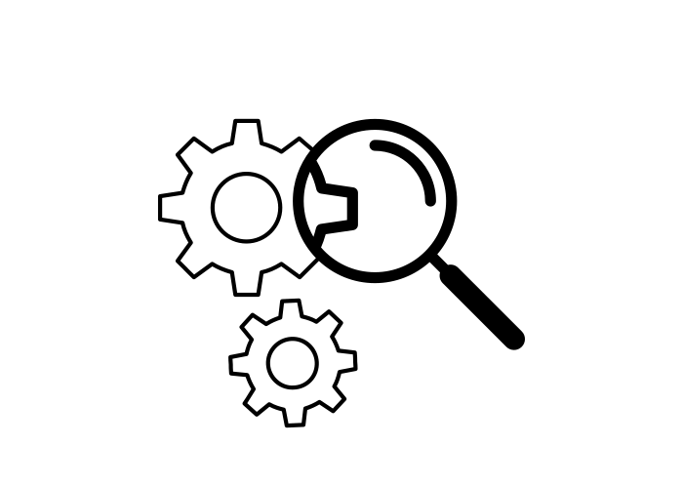
Word | Meaning
learn (verb) | To acquire knowledge or skills by study or instruction.
In a Sentence | Drawing
I learn a lot from my teacher.

Slide 43
Word | Meaning
library (noun) | A place with a collection of material for; reading, listening, viewing and studying.
In a Sentence | Drawing
I go to the library everyday to study.

Slide 44
Word | Meaning
natural (adjective) | Existing or formed by nature.
In a Sentence | Drawing
This forest is an example of natural beauty.

Slide 45
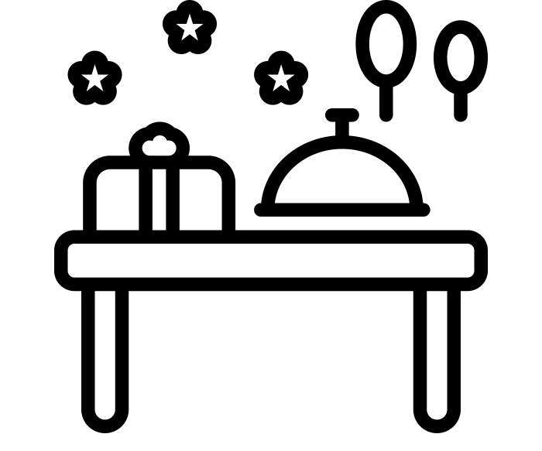
Word | Meaning
occasion (noun) | A particular time or circumstance.
In a Sentence | Drawing
This is event an important occasion for us.

Slide 46
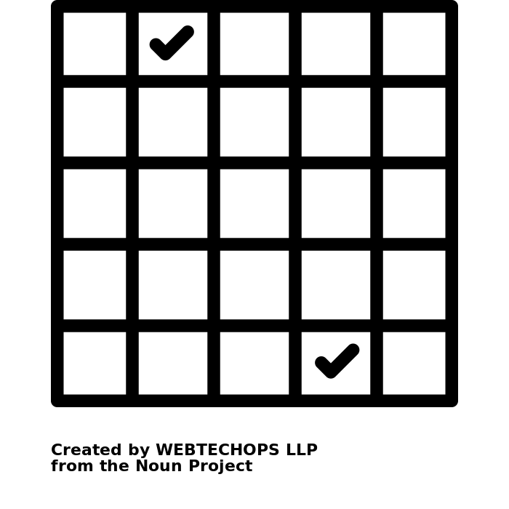
Word | Meaning
occasionally (adverb) | At times; now and then.
In a Sentence | Drawing
Occasionally I go to the beach.

Slide 47
Word | Meaning
often (adverb) | Many times or frequently.
In a Sentence | Drawing
I often go to the gym to exercise.

Slide 48
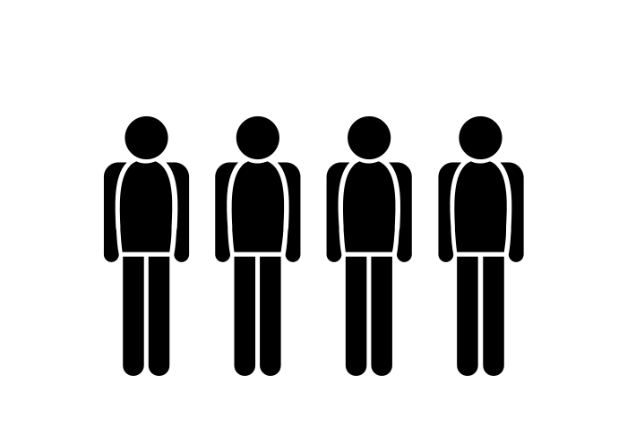
Word | Meaning
ordinary (adjective) | Of no special interest or quality.
In a Sentence | Drawing
I wear ordinary clothes to work.

Slide 49
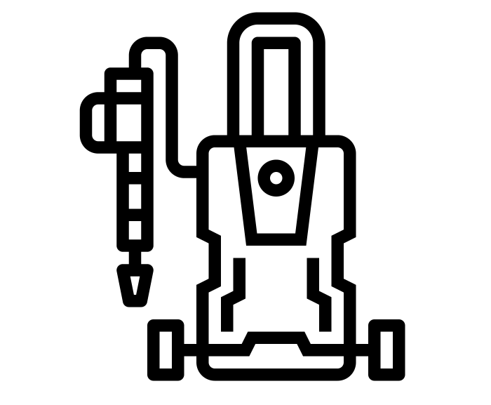
Word | Meaning
pressure (noun, verb) | Noun - force upon a surface from an object or fluid. Verb - to force or influence someone.
In a Sentence | Drawing
Noun - The pressure of water will break through the pipes. Verb - I feel pressure to answer the question correctly.

Slide 50
Word | Meaning
probably (adverb) | Very likely to happen.
In a Sentence | Drawing
It will probably rain tomorrow.

Slide 51
Word | Meaning
quarter (noun, verb) | Noun - four equal parts of an object. Verb - to divide into equal parts.
In a Sentence | Drawing
Noun - A quarter of this pie is enough for me to eat. Verb - I quarter the pie into equal slices.

Slide 52
Word | Meaning
reign (noun, verb) | Noun - sovereign occupies the throne. Verb - to exercise power and authority (linked to the sovereign).
In a Sentence | Drawing
Noun - The Queen has had a long reign over the UK. Verb - The Queens reigns over the UK.

Slide 53
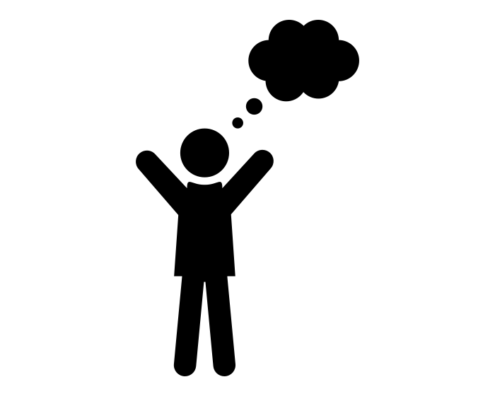
Word | Meaning
remember (verb) | To recall a memory or think of again.
In a Sentence | Drawing
I remember my first teacher.

Slide 54
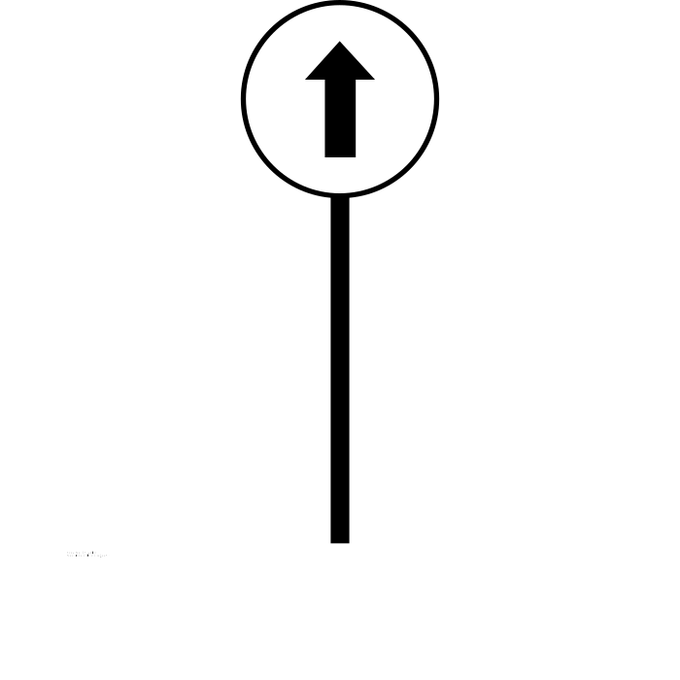
Word | Meaning
straight (adjective, adverb) | Adjective - without a bend or angle. Adverb - in a straight line.
In a Sentence | Drawing
Adjective - The ruler is straight. Adverb - I walk straight across the road.

Slide 55
Word | Meaning
strange (adjective) | unusual or surprising; difficult to understand or explain.
In a Sentence | Drawing
She was a strange character.

Slide 56
Word | Meaning
various (adjective) | Different kinds of two or more things.
In a Sentence | Drawing
Various experiments have not proved his idea.

Slide 57
Word | Meaning
weight (noun) | Unit of measure for heaviness or mass.
In a Sentence | Drawing
The weight of this stone is 75kg.

Slide 58
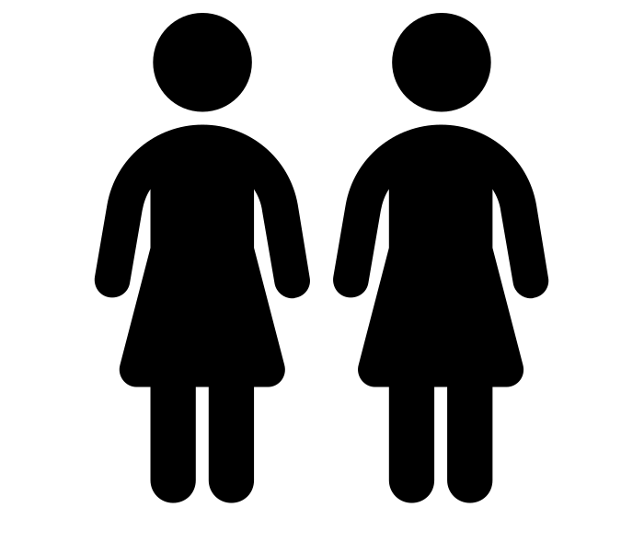
Word | Meaning
woman/women (noun) | Adult female person. Plural - women (more than one woman)
In a Sentence | Drawing
A woman called Sarah called for you today. The women gathered together for a photo.

